Slide 1

DATE
Taxes 101
Don’t Leave Money on the Table!

Slide 2

Agenda
Part I
Introductions and Ice Breakers
What Are Taxes, Why Should I File Them, and When?
What Are Tax Credits?
How Can I Avoid Owing Taxes When I File?
Part II
How Do I Prepare to File My Taxes?
How Do I File My Taxes?
What Happens After I File My Taxes?

Slide 3
Introduction

Slide 4

TAXES

Slide 5
Where are you?
Not ready or confident…yet
Ready & confident!
0
10
On a scale from 0-10, how do you feel about filing your taxes?

Slide 6
What Are Taxes?
Why Should I File Them?
When Should I File Them?

Slide 7
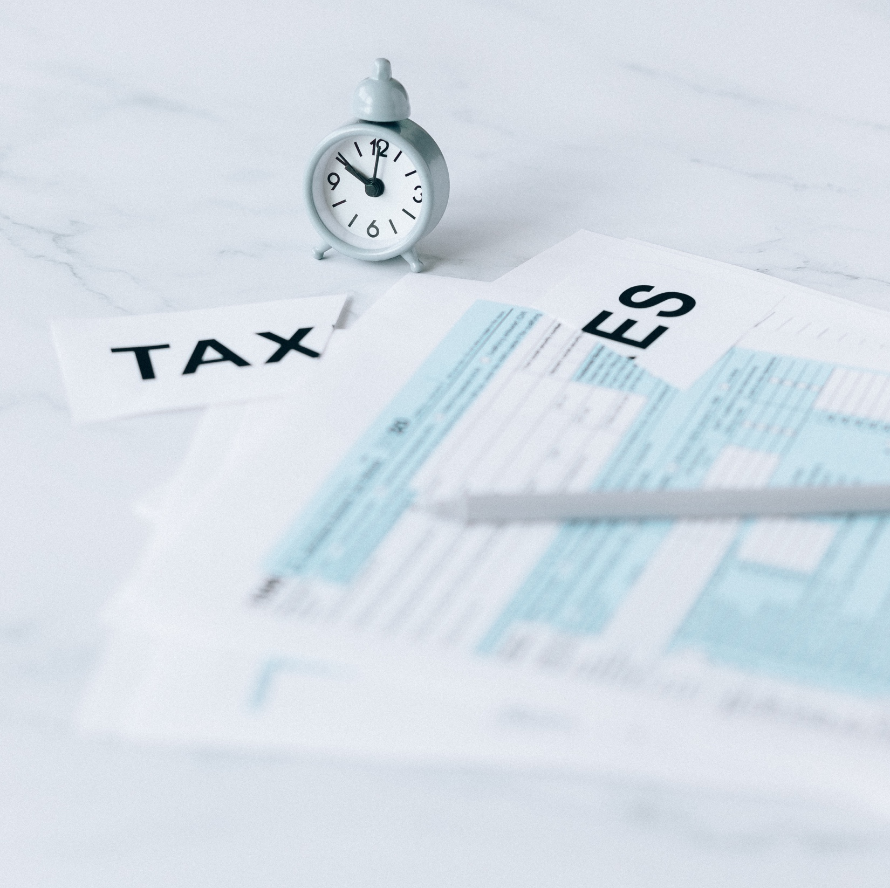
What Exactly Are Taxes?
Taxes provide revenue for federal, local, and state governments to fund:
Essential services intended to benefit all citizens
E.g. defense, highways, police, a justice system
Programs and services that benefit certain citizens
E.g. health, welfare, social services, job training, schools, parks

Slide 8
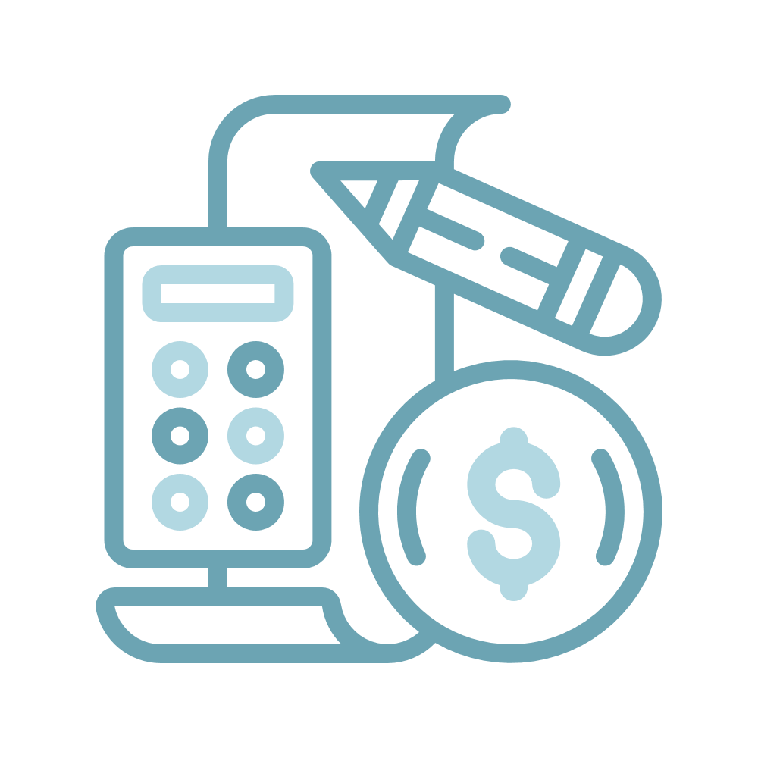

What Are Income Taxes?
Income taxes reduce taxpayers’ income.
The rate at which people are taxed (your “tax bracket”) depends on how much money they make.
Usually higher-income taxpayers pay a higher rate of income tax than lower-income taxpayers.
The amount of money withheld from each paycheck determines whether you owe money or you are owed money at the end of the year, and how much.
This is why the information you provide on your W-4 when you start a job, is so important!

Slide 9
Who Must File
On 12/31/25, my filing status was: | And on 12/31/25, my age was: | California Gross Income
 |  | Number of Dependents
 |  | 0 | 1 | 2 or more
Single or Head of Household | Under 65 65 or older | $22,941 $30,591 | $38,774 $42,466 | $50,649 $51,966
Married filing jointly Married filing separate | Under 65 (both spouses) 65 or older (one spouse) 65 or older (both spouses) | $45,887 $53,537 $61,187 | $61,720 $65,412 $73,062 | $73,595 $74,912 $82,562
Note: If you are self-employed* and earned above $400, then by law, you are required to report your Form 1099 and file your taxes.
"Self-employed" includes gig work like driving for ride-share or food delivery and independent contractor work, such as a part-time youth advocate.

Slide 10
Who Should File?
You should file your taxes if:
You should not file your taxes if:
You are not required to by law AND
You will owe money when you file
You are required to by law AND/OR
You will receive money back from filing
Estimate whether you will owe taxes or receive a tax refund when you file:
Federal (IRS): https://www.irs.gov/help/ita/do-i-need-to-file-a-tax-return
State (FTB): https://www.ftb.ca.gov/file/personal/credits/EITC-Calculator/Home

Slide 11
Why Should I File Taxes if I Don’t Have to?
In 2025, current & former foster youth ages 18-25 who filed received an average of:
$1,857 cash back for single filers
$4,008 cash back for parenting filers!
Just 5% owed taxes.
Cash Money!
Tax filing is how you access state or federal relief
Important independent living skill—eventually we all have to do it!
Establishes income for public benefits; tax refunds aren’t counted against eligibility
Uncovers identity theft

Slide 12

When is tax season?
January: Tax filing season begins
April: Tax deadline for people who owe taxes
October: Tax deadline for people who do not owe taxes

Slide 13

Check-In: What Have We Learned?
?
?
Everyone take a moment and think of two things you learned from this first section.

Slide 14
What Are Tax Credits?

Slide 15


Cash Back Tax Credits Put Money in Your Pocket
A Tax Credit reduces the amount of money you owe the government.
A nonrefundable tax credit does not provide cash back, it just reduces what you owe.
A refundable or “cash back” tax credit reduces what you owe, then once you owe $0, you get to keep whatever is left of the credits. (You get a refund = cash back)
In 2025, 92% of current and former foster youth ages 18-25 owed no taxes. They got to keep their cash back credits!

Slide 16
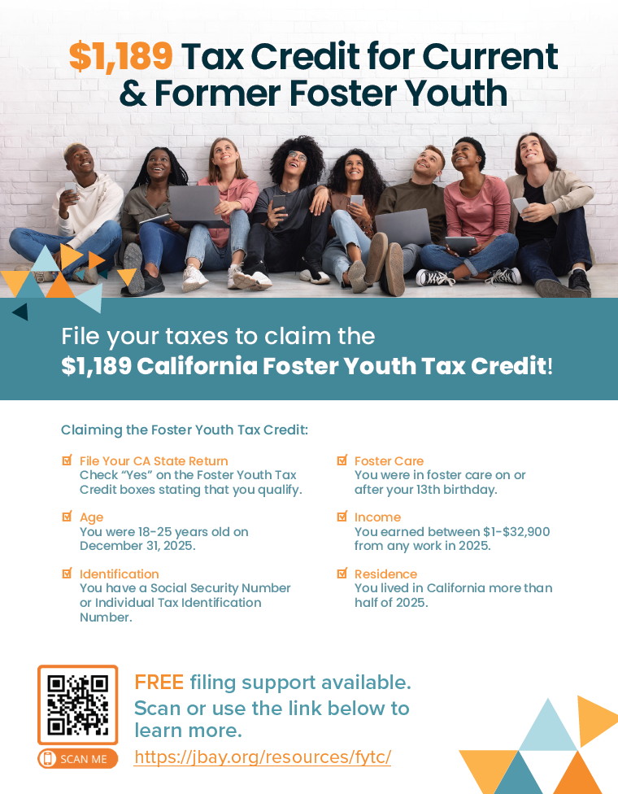
New Tax Credit Just for Current & Former Foster Youth!
The California Foster Youth Tax Credit (FYTC)
First of its type in the nation! Became available in 2023. The FYTC is a cash back tax credit.
In 2026, the FYTC will provide up to $1,189 to youth who:
File their 2025 state tax return
Are age 18-25 at end of the tax year (12/31/25)
Were in foster care on or after 13th birthday
Earned between $1 - $32,900 in 2025
Lived in CA at least half of 2025
Download the flyer: https://jbay.org/resources/fytc-flyer/

Slide 17
Other Tax Credits You May Be Eligible For
State Tax Credits
California Earned Income Tax Credit (CalEITC)
Young Child Tax Credit (YCTC)
Child & Dependent Care Expenses Credit*
Renters Credit*
Federal Tax Credits
Earned Income Tax Credit (EITC)
Child Tax Credit (CTC)
Child & Dependent Care Tax Credit
American Opportunity Credit and Lifetime Learning Credit*
* The credits with asterisks are not refundable. They will just reduce what you owe, if you owe anything.

Slide 18
Check-In: What Have We Learned?
?
?
Everyone take a moment and think of two things you learned from this first section.

Slide 19
How Can I Avoid Owing Taxes When I File?

Slide 20
Youth usually don’t owe, but a small number will…here’s why.
Most common reasons current and former foster youth ages 18-25 owed taxes in the last three years:
Filled out their W-4 wrong
Was self-employed/had gig work income
Spent educational financial aid on non-qualified expenses

Slide 21
When You Start a Job, Filling Out Your W-4 Correctly is Important
You should complete a W-4 anytime you start a new job or your tax situation changes.*
Your W-4 helps your employer determine how much federal income tax to withhold from your paycheck for the government.
If the form is not filled out correctly, too much or too little will be withheld.
If too little tax money is withheld from your paycheck, you will owe the government money when you file.
*Exception: If you’re self-employed you don’t complete a W-4

Slide 22
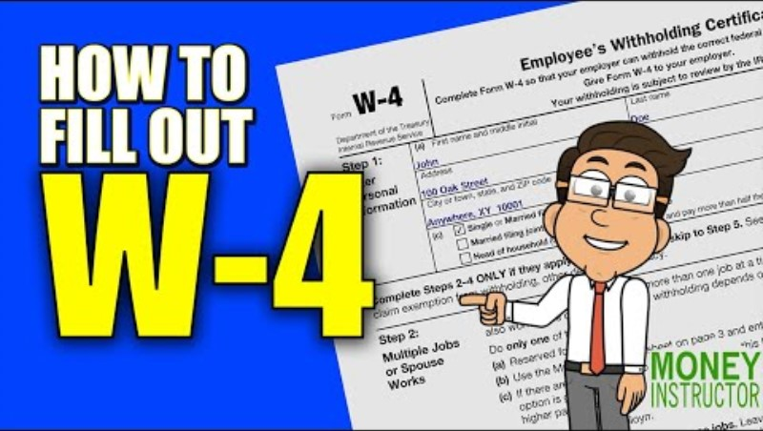

Slide 23

If you’re self-employed or do gig work, save money to pay your taxes.
When you are self-employed (which includes gig work such as Uber/Lyft, UberEats, DoorDash, etc.), no taxes are taken out of your paycheck to pay the government.
You will likely owe taxes if you file because you haven’t been paying them throughout the year.
If you earn enough to be legally required to file taxes, it is important to put money aside from each paycheck so that you can use that money to pay your taxes later.
30% recommended

Slide 24
Spending your financial aid on qualified expenses is important.
Qualified expenses: -Tuition and fees
-Course-related expenses such as books, supplies (pens/paper), and equipment (includes laptops/Chromebooks and computer software)
Non-qualified expenses: -Room & board (inclu. dorm)
-Student health fees
-Cafeteria food card
-Research, equipment, other expenses not required for course
-Travel
-Clerical help
Certain financial aid is taxable if it is not spent on “qualified expenses.”
College students should try whenever possible, to spend their aid on qualified expenses, and to save receipts for those expenses.

Slide 25
Check-In: Quiz!
True or False?
1. A W-4 is a form you fill out when you start a new job or when your tax situation changes.
2. If you fill out your W-4 incorrectly, you may have too little or too many taxes taken out of each paycheck.
3. If you are self-employed (including gig work), no money is being taken out of your paycheck for taxes so if you file, you may owe.

Slide 26
How Do I Prepare to File My Taxes?

Slide 27
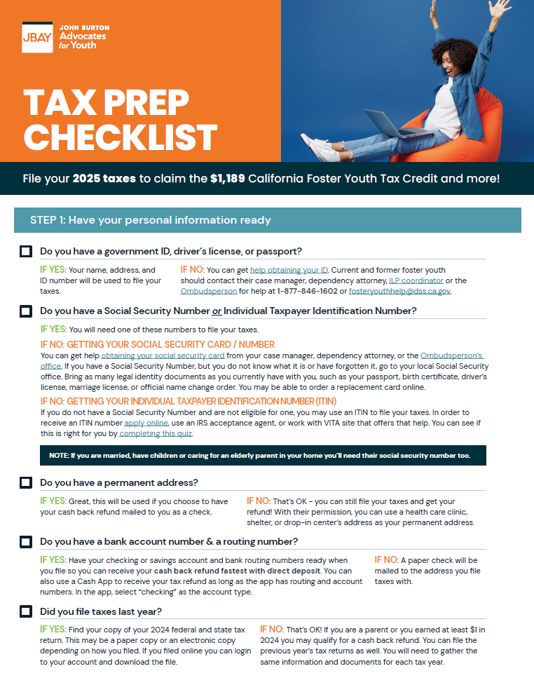
The Tax Prep Checklist Will Tell You How to Prepare for Filing Your Taxes.
Government ID, driver’s license, or passport
Social Security Number or Individual Taxpayer ID Number (ITIN)
Foster care verification letter (optional)
Permanent address
Bank account & routing number
Last year’s taxes (if filed)
W-2 if employed
1099-NEC or 1099-MISC if self-employed
1099-G if received unemployment
1099-INT if have savings account
1098-T if have educational financial aid
Receipts for qualifying educational expenses not covered by financial aid
Receipts from childcare, day care/paid preschool, summer day camps, babysitters if parenting
Download: https://jbay.org/resources/tax-prep/

Slide 28

Check-In: Are You Ready?
Share out with your group:
Are there items/documents you’re missing?
If yes, do you have the information you need to obtain the missing items?

Slide 29
How Do I File My Taxes?

Slide 30



There are Three Main Ways to File Your Taxes
Self-File
FREE if you use a free program
File with Assistance from an IRS-Certified Volunteer
FREE
File with a Paid Preparer
COSTS (not recommended)

Slide 31

Self-Filing
This is the most common way to file for young adults.
File for free at myfreetaxes.org
JBAY’s Self-Filing Guide walks you through this process screen by screen: https://jbay.org/resources/self-filing-guide/
You can also self-file using Turbo Tax, etc. but unless you get the free version, you will pay for these programs.
Note: The free version of Turbo Tax is not available to those who are self-employed (have 1099 forms).
Don’t miss the Foster Youth Tax Credit! Make sure you select the correct boxes on their state tax return to receive it.

Slide 32





File With Assistance from an IRS-Certified Volunteer
Volunteer Income Tax Assistance (VITA) Sites offer free, one-on-one tax return preparation to people who earn $69K or less.
IRS-certified volunteers do the tax preparation.
Some VITA sites offer remote assistance.
There are not enough VITA sites to serve all eligible individuals, and there are “VITA deserts” in some regions of the state.
Locate a VITA site for foster youth or a general VITA site using this roster: https://jbay.org/resources/fy-vita-sites/.
If you use a general site, make sure you bring info with you about the FYTC: https://jbay.org/resources/fytc-info-for-tax-preparers/

Slide 33
Paid Preparers: Proceed with Caution
Why shouldn’t I use a paid preparer to file my taxes?
They miss the Foster Youth Tax Credit: In 2025 just 8% of FYTC claimants were assisted by a paid preparer vs. 56% of CalEITC claimants.
Upwards of 60% of paid preparers make errors on tax returns.
Some paid preparers use predatory practices (e.g. refund advancements w/ interest).
If they miss a credit, you will have to pay again for the preparer to amend (correct and re-file) your taxes.
If you choose to use a paid preparer:
Take information about the Foster Youth Tax Credit to ensure they don’t miss it: https://jbay.org/resources/fytc-info-for-tax-preparers/.
If they miss the FYTC or other credits, you can amend your taxes at a VITA site for free.

Slide 34

Which Filing Method is Right for Me?
Self-Filing may be right for you if:
You’ve filed before
You’re pretty good at doing things independently and following written guidance
Your tax situation is pretty simple (no self-employment/gig work, no financial aid)
Filing at a VITA site may be right for you if:
You’re experiencing identity theft/you’re a victim of tax fraud
You have a complicated tax situation (e.g. have self-employment/gig work income, you have educational financial aid, etc.)
You’re really nervous about filing and want one-on-one support
(Filing with a paid preparer is not recommended).

Slide 35
Check-In: What Have We Learned?
?
?
Everyone take a moment and think of two things you learned from this first section.

Slide 36
What Happens After I File My Taxes?

Slide 37

What if I Uncovered Identity Theft While Filing?
What do you mean by identity theft/tax fraud?
Someone claims you as a dependent on their tax return that shouldn’t.
Someone steals your Social Security Number to try to claim your credits and direct to their bank account.
Who is legally allowed to claim me as a dependent?
Someone may be able to claim you as a dependent on their tax return if they provided at least half of your support for the tax year.
**If this applies to you, ask your trainer for more information to see if you meet the other guidelines for being claimed as a dependent.**
If someone claims you that is not supposed to, that is tax fraud.

Slide 38
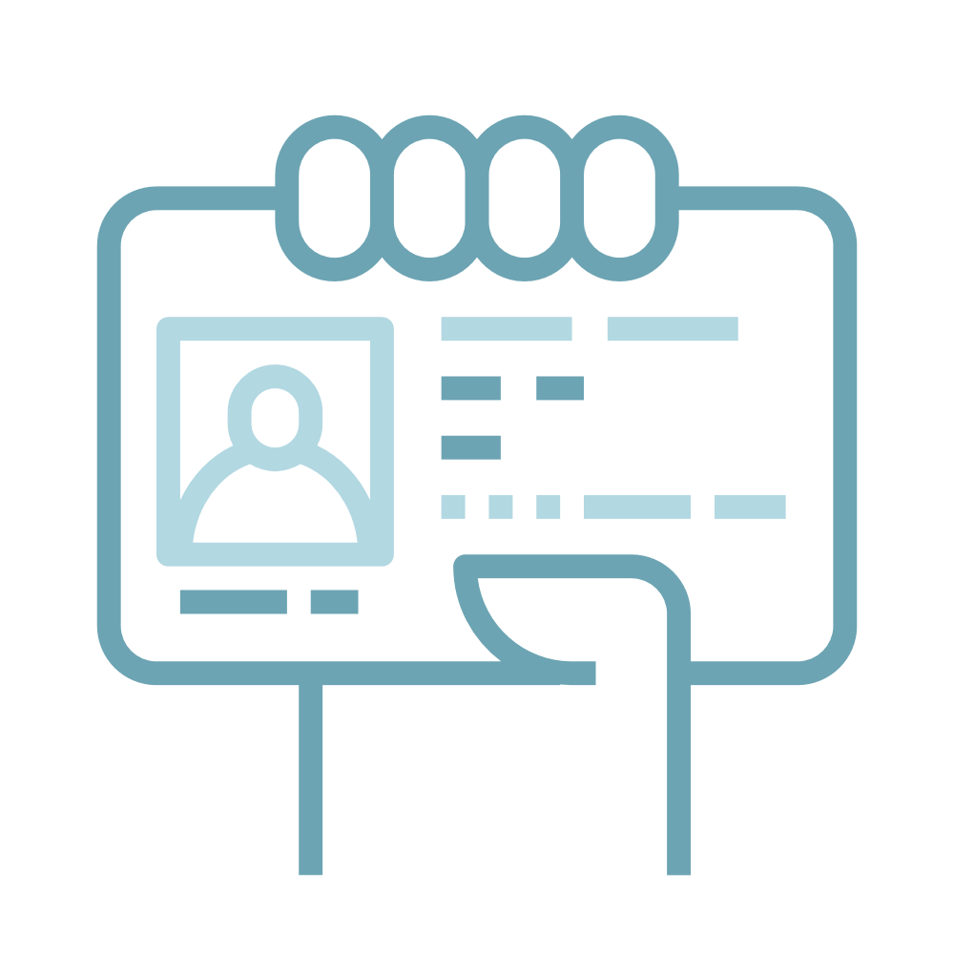
How Do I Address Identity Theft?
Talk to your county child welfare agency:
Current nonminor dependents ► Seek assistance from your social worker or dependency attorney to resolve the issue.
Former foster youth ► Seek assistance from legal aid or check in with county child welfare agency about whether they can refer you to a specific organization addressing this for foster youth.
Resources:
Low Income Taxpayer Clinics (LITC) Taxpayer Advocate Services: https://www.taxpayeradvocate.irs.gov/about-us/low-income-taxpayer-clinics-litc/
If you’re in the Bay Area try Bay Area Legal Aid: https://baylegal.org/what-we-do/stability/

Slide 39
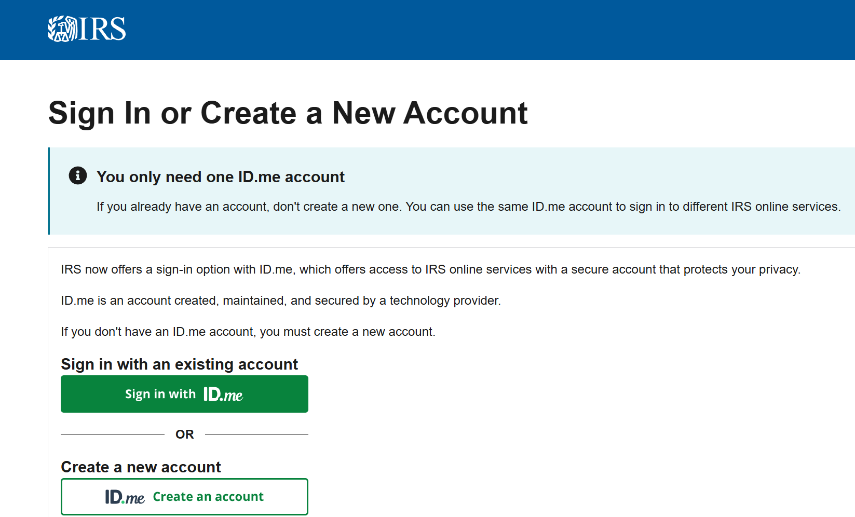
If You Experience Identity Theft, You Should Use an Identity Protection Pin (IP PIN)
The IP PIN acts as an authentication number to validate the correct owner of the SSN(s) or ITIN(s) listed on your tax return.
IP PINS protect from identity theft
A new IP PIN will be generated each year (don’t lose the IP PIN #)
Helps to facilitate the tax filing process
Create an ID.ME account on the IRS website

Slide 40

When to Amend a Return
Amending a tax return means correcting it and re-filing. You should do this when:
You forgot to enter a W-2
You chose the wrong filing status (i.e. single, head of household, etc.)
You did not claim the correct number of dependents
You discovered a credit or deduction you should have claimed
The amount of earned income you reported is incorrect
You received a form, such as a 1099 after you already filed your taxes
How do I amend my taxes?
You can do it yourself at myfreetaxes.org or if you used Turbo Tax you can do it there.
If you want support, visit a VITA site to amend your taxes but be sure to bring a copy of your original return and all tax documents.
Did you miss the Foster Youth Tax Credit?!

Slide 41

Important Communications from the IRS or FTB
What if I get a letter from the IRS or Franchise Tax Board?
You must respond within 30 days!
This usually means the IRS need additional information to file your taxes (e.g. verification of foster youth status if the state match fails, verification that a child is in your care, verification of self-employment income, etc.)
Caution: The IRS sends letters. They DO NOT call, email, or connect through social media. Do not give out your Taxpayer Identity Protection Pin, bank account number, or Social Security Number.

Slide 42

Taxes Are Filed…Now What?
How do I check for my tax refund?
Federal: https://www.irs.gov/refunds
State: https://www.ftb.ca.gov/refund/index.asp
Note: e-filing takes less than 3 weeks; paper filing takes 6-8 weeks. Direct deposit is the quickest way to receive your refund.
How do I prepare for next year?
Save documents for next year!
Taxes from last tax season, receipts for higher education and self-employment expenses, W-2s, etc.
It is recommended you keep records of 5 years of tax returns

Slide 43
Where are you?
Not ready or confident…yet
Ready & confident!
0
10
On a scale from 0-10, how do you feel about filing your taxes?

Slide 44


Slide 45
Thank You

