Slide 1
Turning Dreams into Degrees
Education Course 1:
Supporting Foster Youth through Early College Awareness and Preparation
April 2024
Notes:
Trainer’s Note: Use this opportunity to provide welcome and introductions, depending on the size of your group.

Slide 2
Acknowledgements
This presentation was created by John Burton Advocates for Youth (JBAY) with support from UNITE-LA, the Foster and Kinship Care Education Programs of LA County, the LA County Department of Children and Family Services, Foster Parent College and the LA Opportunity Youth Collaborative (OYC).
This curriculum is part of an overall strategy within the LA OYC’s Foster Youth College Advancement Project initiative, led by JBAY, to increase postsecondary attainment for foster youth.
Notes:
This presentation was created by John Burton Advocates for Youth and UNITE-LA, with support from with support from the Foster and Kinship Care Education Programs of LA County, the LA County Department of Children and Family Services, Foster Parent College and the LA Opportunity Youth Collaborative.

Slide 3
Today’s Learning Objectives
Explain the benefits of postsecondary education
Recognize the unique barriers foster youth face in education, including the impact of trauma
Identify strategies to create a college-going culture in the home
Understand the different postsecondary education pathways
Identify resources and strategies to help students explore their career interests and achieve their postsecondary education goals
Describe key educational planning milestones between 6th-10th grade
Notes:
For caregivers with youth in middle school or in the early high school grades, a higher education can seem so far into the future that it can take secondary importance to more immediate concerns. For youth to succeed in postsecondary education and become independent, they need encouragement and help preparing early on. We believe caregivers have the opportunity to play this role, and middle school—if possible—is a good time to begin. This course will provide caregivers* with tools and information to help their youth achieve the higher education needed to turn their dreams into degrees.
After today’s course you will be able to:
Explain the benefits of postsecondary education
Recognize the unique barriers foster youth face in education, including the impact of trauma
Identify strategies to create a college-going culture in the home
Understand the different postsecondary education pathways
Identify resources and strategies to help students explore their career interests and achieve their postsecondary education goals
Describe key educational planning milestones between 6th-10th grade
This course is designed for ALL caregivers, regardless of your own level of education and experience with college.
*Trainer’s Note: This training is intended for caregivers, including both Resource Parents and STRTP providers. In these notes, you will see the term caregivers, but please feel free to customize your remarks to specifically indicate the appropriate audience, as needed.

Slide 4
Found here:
www.jbay.org/resources/edcourse1-caregiver-supporting-materials/
Supporting Materials
Notes:
Throughout the training we will share various supplemental materials and resources. All accompanying materials for caregivers can be found in the Foster Youth Postsecondary Guide: www.jbay.org/resources/edcourse1-caregiver-supporting-materials/
Trainer’s Note:
The link to the Caregiver Supporting Materials can be shared with attendees via chat or materials can also be printed for in-person sessions.

Slide 5
Postsecondary Education Planning Guide for Adults Supporting California’s Foster Youth
Use the Foster Youth Postsecondary Education Planning Guide for step-by-step information how to prepare and apply to college
Includes companion youth-facing versions for high school students.
Available at: www.jbay.org/resources/ed-planning-guide/
Notes:
One of the resources found with the Supporting Materials is the new Foster Youth Postsecondary Education Planning Guide any of the resources and information shared throughout this training can be found within this guide.
This guide can be a helpful tool to remember all the steps necessary from middle school to high school to successfully prepare a foster youth for postsecondary education with downloadable grade-specific checklists.
This guide also includes an overview of the resources available to foster youth found at both California community colleges, CSU’s and UC’s.
In today’s training, we will just review the key educational planning milestones in 6th-10th grade, however this guide includes important steps and details for those in 11th and 12th grade as well.
There is also a companion youth-facing version for high school students, with embedded student videos found within both guides.
Trainer’s Note: This newest updated guide was published in English and Spanish in March 2023. A current version of the guide can be downloaded at: www.jbay.org/resources/ed-planning-guide/

Slide 6
Postsecondary Education
Any formal education after high school.
Notes:
Before we begin, let’s define postsecondary education.
Postsecondary education, or higher education, is generally any formal education that happens after high school. This can include apprenticeships, trade school, career and technical education, such as Job Corps, community college, or a traditional 4-year college or university. We'll talk more about these different types of postsecondary education later in this course, and we will use the terms higher education, college and postsecondary education interchangeably to refer to the various education pathways following high school.

Slide 7
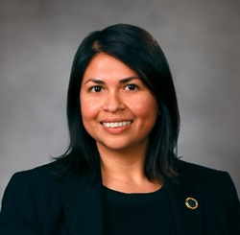
Are they a former foster youth?
Colin Kaepernick,
Former NFL Quarterback
Attended University of NV
Dr. Daisy Gonzalez
Deputy Chancellor,
California Community Colleges
Attended LA Valley College, Mills College, and UC Santa Barbara
Faith Hill,
Singer
Attended Hinds Community College
Steve Jobs,
Co-Founded of Apple,
Attended Reed College
Simone Biles,
Olympic Gold Medalist,
Attended University of the People
Notes:
**Trainer’s Note-Interaction Opportunity (4 minutes):
In-person: To use this slide as an interaction opportunity, the facilitator can show all individuals on the slide and then ask attendees to identify the person in each image. Next, the facilitator can go through each person on the slide and ask the group to vote by show of hands for the individual or individuals who they think is a former foster youth.
Via Zoom: If this training is administered via Zoom, the facilitator can either ask the attendees via the chat box to identify the individual or unmute participants who “raise their hand” to answer. Determine the most time efficient method depending on the size of your audience. Attendees can then use the “thumbs up” or “yes or no” reactions to cast their votes about who they think is a former foster youth or the facilitator can create a multiple-choice poll, set to anonymous, with each individual listed and allow attendees to select all that apply.
After participants make their guesses either virtually or in-person, you can go to the next slide.

Slide 8
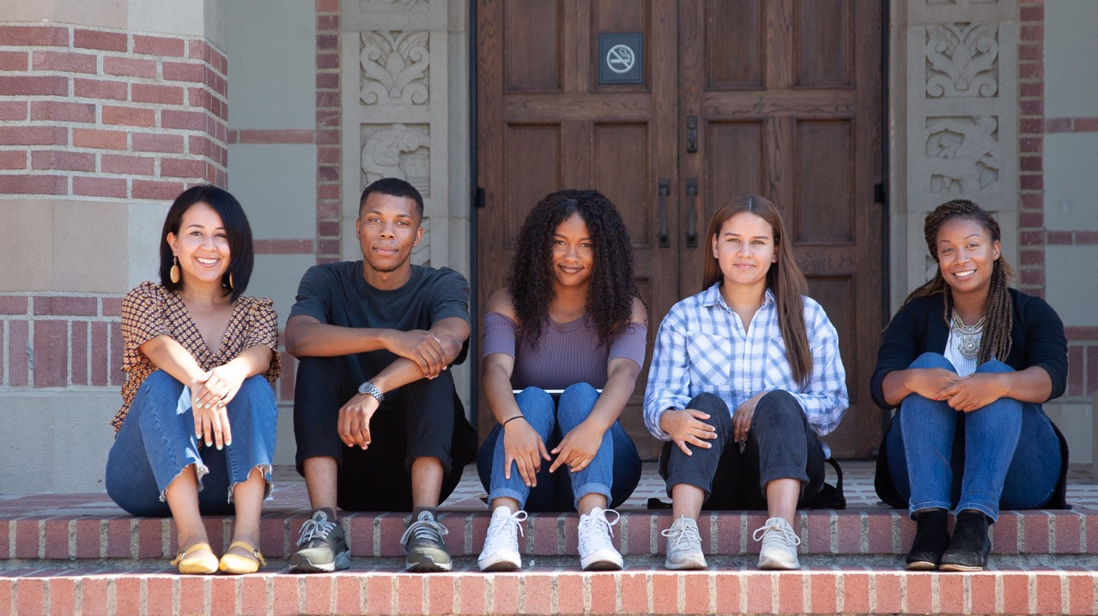
Despite the barriers, foster youth are going to college and beating the odds!
Notes:
In fact, all of these individuals had some involvement in the foster care system. This shows us that, despite the challenges that foster youth may face, attending college and building a successful future is possible!
Today’s training will help equip you with the skills and resources to support your youth and help them turn their dreams into degrees.
Trainer’s Note: This is a photo of foster youth students and their support staff from UCLA. Use this slide as an opportunity to share photos of foster youth students and graduates from your agency or local college to continue to promote the message that college is possible. Partner with your local Guardian Scholars or NextUp program to gather photos.

Slide 9
Student
Voices
Let’s hear from several former foster youth who have experienced postsecondary education.
Notes:
Let’s hear from several former foster youth who have experienced postsecondary education.
We will be hearing from them and others throughout this course.
Trainer’s Note:
Click on the text box to be directed to the link with the video. NOTE: Many YouTube videos have advertisements that will play before the video. Check the Trainer’s Guide for some tips and tricks on how to set up these linked videos.

Slide 10
Why college?
Understanding what is at stake for our youth.
Notes:
Now that we have heard from the youth, why is higher education so important?

Slide 11
Median Annual Salaries,
by Education Level
$74,464
$52,260
Education
Pays Off
$44,356
This translates to $1 MILLION more dollars over your lifetime!
High school Diploma
Associate Degree
(2-year degree)
Bachelor’s Degree
(4-year degree)
Source: College Board, “Education Pays 2023”
Notes:
Simply put, the investment you make to pursue a college degree pays off in terms of future earnings. As you can see, the average annual salary of someone with only a high school diploma is about $44,000 compared to about $74,000 for someone with a 4-year degree, or bachelor’s degree.
When added up over the course of one’s lifetime, the difference in earnings can equal to a million more dollars!
Source: https://research.collegeboard.org/trends/education-pays

Slide 12
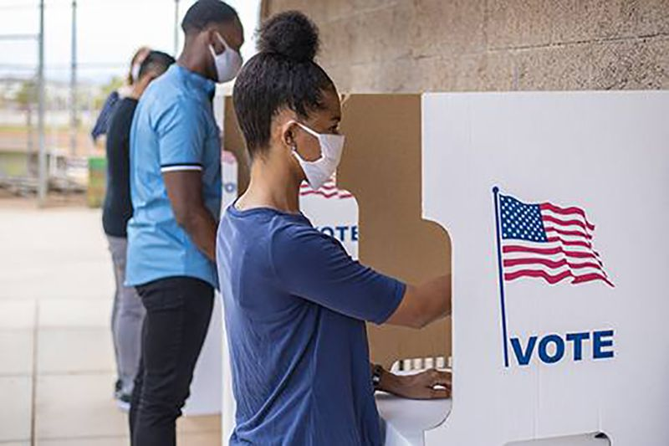
Education Pays Off in Other Ways…
01
04
05
02
03
Lower unemployment rates
Improved health outcomes
Increased volunteering, voting and lower rates of incarceration
Greater likelihood of one’s children attending college
Increased career satisfaction
Notes:
Having a higher education also pays off in other ways.
Not only do college graduates earn more on average, but they also have greater job stability and lower rates of unemployment.
College is the key to ensuring economic security. Nationally, 70% of all jobs require postsecondary education
On the flip side, there are fewer options for those without college degrees now, and there's more competition for jobs that pay less and have less security. Investing in a college degree is a much better deal- you have more options that pay better, too!
A college degree is also associated with other positive life outcomes such as improved health outcomes, increased volunteering, voting and lower rates of incarceration and there is a greater likelihood of one’s children attending college.
The goal isn’t just getting foster youth a job, but helping them achieve meaningful careers, and become self-actualized adults. It’s thinking beyond self-sufficiency and recognizing that higher education is a key part of achieving well-being.
Sources:
https://research.collegeboard.org/trends/education-pays
https://cew.georgetown.edu/wp-content/uploads/2014/11/Recovery2020.SR_.Web_.pdf
https://research.collegeboard.org/pdf/education-pays-2004-full-report.pdf

Slide 13
What percentage of foster youth in California…
Question 01
Question 02
Question 03
Want to go to college?
Enroll in college?
Earn a 2-year or 4-year degree?
Answer 01
Answer 02
Answer 03
91%
52%
10%
Notes:
While we know the benefits of postsecondary education, how do our youth feel about it?
What percentage of youth do you think want to go to college?
Most youth in care- 91% in California- report that they want to go to college and understand that college is desirable.
While this is positive, aspiring to go to college ad making it through to that degree are two different things.
What percentage of youth who experienced foster care enroll in college?
52% of youth in California who graduate from high school enroll in postsecondary education within one year after graduation.
While most youth who experienced foster care want to go to college, the reality is that they face many obstacles that need to be overcome prior to actually enrolling in college.
Lastly, what percentage of youth who experienced foster care do you think achieve a college degree by the age of 23?
Unfortunately, youth who experienced foster care face unique challenges that result in just 10% completing a college degree by the age of 23. While this number is low, it is important to note that it has been increasing in recent years!
Early in their schooling, youth in care often get labeled as “not college material” or “not college ready.” These negative labels are due to a range of unique barriers and challenges that these youth may face, due to no fault of their own. We will talk more about these challenges in the next section and what caregivers can do to improve these outcomes, and help youth to reach their higher education goals.
**Trainer’s Note- Interaction Opportunity (3 minutes):
In-person: The facilitator can ask some attendees to share their guess before revealing each correct answer. Alternatively, the facilitator can give various options and ask attendees to raise their hands.
For example, for question 1- “How many people think the correct answer is between 20-30%? 30-50% 50-80?% Or 80-95%?”
Via Zoom: If facilitating a small group, attendees can unmute themselves to share a guess. Alternatively, attendees can be asked to share their guess in the chat function or a poll can be created via Zoom to allow attendees to guess the correct answer for each question.
Source:
- Question 1: CalYouth Study (http://www.chapinhall.org/sites/default/files/CY_YT_RE0516_1.pdf) page 64.
- Question 2: California Department of Education, DataQuest, 2018-2019 College-Going Rate for California High School Students. Note: This number decreased in 19/20 due to the impact of the pandemic to 44.3%.
- Question 3: https://www.chapinhall.org/research/calyouth-wave4-report/

Slide 14
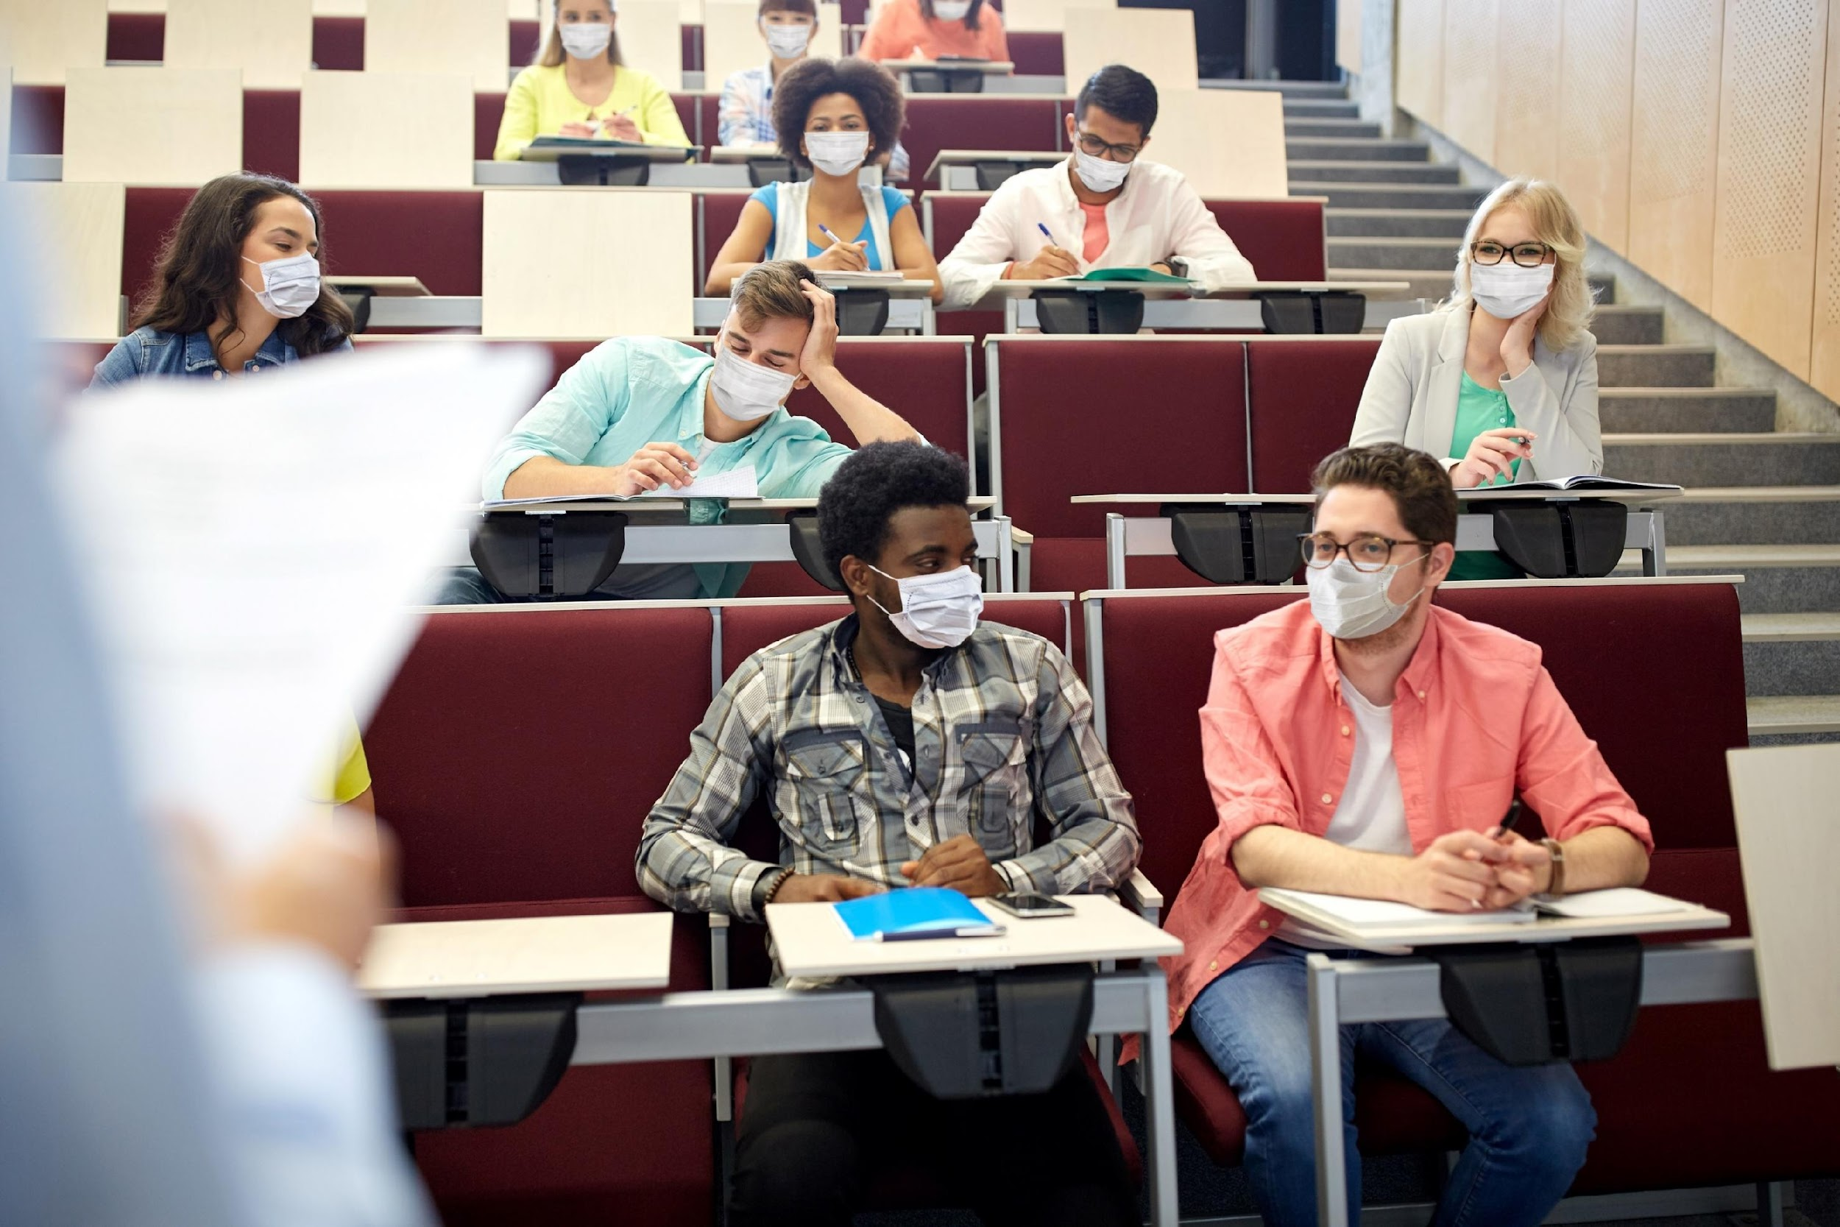
Reflection
How do you feel about college?
What are your fears or concerns about college for your youth?
What questions do you have about college?
Notes:
Our perceptions of college are informed by many external messages and information that we receive from family and friends, teachers and counselors, peers, the media, and of course, caregivers.
Let’s take some time to reflect on your thoughts about college, any fears or concerns about college for your youth, and a question about college that you might have. Throughout the training we will aim to address these questions and concerns and think about how your perception of college may inform or influence your youth.
**Trainer’s Note- Interaction Opportunity (10 minutes): Here’s a chance to get your audience engaged. Take 10-15 minutes to try one of our suggested facilitation activities:
In-person:
Pair and Share: Ask participants to introduce themselves to one person seated next to them. As a pair, participants will ask each other the questions listed on the slide. Once the facilitator calls participants back into one large group, volunteers will share back what responses their partner provided. The facilitator will then guide the discussion to identify common themes and experiences.
Post-It Collage: Before the presentation, the facilitator can place 3 Post-It notes at each seat. The facilitator can ask audience members to jot down their answers on each Post-It that correspond to questions #1-3. Participants can then stick their notes up on a wall in a section that corresponds to the question. The facilitator can cluster common responses together and read aloud the messages that were most common and guide group discussion.
Poll the Audience: Before the presentation, the facilitator can place a red note card and a green note card at every seat. The facilitator can read aloud several statements and ask participants to hold up a green card if they agree with the statement (or if the statement applies to them) or to hold up a red card if they disagree with the statement (or if the statement does not apply to them). For example, the facilitator might read aloud the statement “I think that college is essential to achieving a meaningful job” or “I think that college is expensive.” Facilitator can then call on 1-2 volunteers to elaborate on why they agreed/disagreed with the statement and facilitate a group discussion. The facilitator can then ask 2-3 participants to share any questions they may have about college that they are hoping to get answered during the training.
Via Zoom:
Use a break-out room feature to break attendees into small groups or pairs to answer the following questions using the “Pair and Share” interaction opportunity listed above. Have a transcriber and group leader present the answers to the larger group. Responses can be gathered on the Zoom “Whiteboard” feature, or through other tools such as a Google Doc, or Padlet.
Via Mentimeter:
For larger groups online, Mentimeter can be a great way to poll your audience and engage them in a discussion. The “Word Cloud” feature can be used to get people to respond to question #1 and #2. The Word Cloud will make common responses show in a larger font. The facilitator can react to the responses by highlighting any common themes or patterns. For question #3, the “open ended questions” could be utilized.

Slide 15
Student
Voices
Youth share about their inner feelings regarding attending college when they were in middle school and high school.
Notes:
Let’s take a moment to hear from our youth again. Here, the youth share about their inner feelings regarding attending college when they were in middle school and high school. Let’s start with Michael, who was raised by his grandmother in kinship care and is currently enrolled at USC in their school of business, and then hear from Emmerald, Philip and Taneil.
As we go through the video you will hear that for some youth they either didn’t feel like they were college material or were not interested in attending college. For others, like Taneil, that isn’t always the situation. She is currently attending a 2-year community college with the goal of becoming an attorney.
Trainer’s Note:
Click on the text box to be directed to the link with the video. NOTE: Many YouTube videos have advertisements that will play before the video. Check the Trainer’s Guide for some tips and tricks on how to set up these linked videos.

Slide 16
What unique barriers
do foster youth face in higher education?
Notes:
As mentioned before, many foster youth face unique barriers that are linked with poor academic outcomes.
Let’s take some time to better understand what these barriers are and how we can support foster youth who may be experiencing these obstacles. To do this, lets do an exercise. I will present brief scenarios about youth in care and their educational aspirations. Your job is to determine whether each youth is experiencing a challenge to postsecondary education.

Slide 17
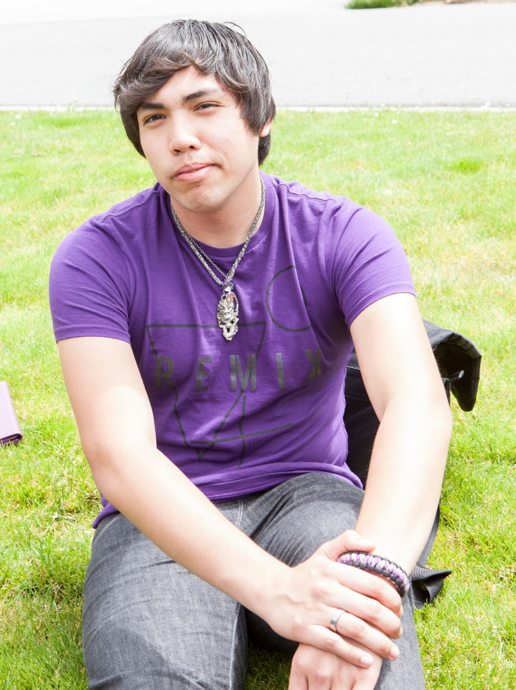
Scenario #1
Elijah is a youth who has experienced several school changes while in care. Could this present a challenge to his college success?
Yes or No?
Yes!
Notes:
Scenario #1- Elijah is a youth who has experienced several school changes while in care. Could this present a challenge to his college success?
The answer is yes! Changing schools is a challenge for any youth, and frequent school changes is one of the biggest challenges youth in care face in achieving academic success. School changes can lead to youth falling behind in the core studies necessary for college, such as math and English and receiving only partial credit for a course. They also disrupt forming or keeping supportive relationships with teachers, peers, and school counselors.
**Trainer’s Note- Interaction Opportunity for slides 16-22 (8 minutes):
This section provides an opportunity for attendees to respond to each case scenario and determine whether each youth is experiencing a challenge related to postsecondary education. The options are generally “yes” or “no”, but please keep in mind that each youth’s experience is unique and the impact of these experiences will vary student to student. These scenarios are intended to explore common themes and generalities for youth in the foster care system. Animation is built into each slide to allow attendees to respond before showing the correct answer.
In-person: The facilitator can simply ask everyone to vote by raising their hand when prompted with the options of either “yes” or “no.”
Via Zoom: Depending on the size of the audience, the facilitator can poll the audience by using the “yes” or “no” reactions, or asking attendees to raise their hand if their camera is on. Additionally, an anonymous poll could be created via Zoom to allow attendees to respond and see the percentage of responses for each option.

Slide 18
Helpful Tip!
Caregivers can support students to stay in their school of origin if they change placements, if it is determined to be in their best interest.
Learn more at: http://www.cfyetf.org/publications.htm
Notes:
Given the impact of changing schools:
For caregivers: caregivers can play a role in advocating for students to stay in their school of origin if they change placements, if it is determined to be in their best interest.
For providers: unless other arrangements are specified in the Needs and Services Plan or the Transitional Independent Living Plan, a provider shall ensure transportation is provided for school, including to the child’s school of origin.
For example, it might be best for the student to finish their semester to take their exams so that it doesn’t interfere with their learning and completion.
Caregivers can learn more about student’s educational rights at the link provided and also contained with all the other training materials found at: www.jbay.org/resources/edcourse1-caregiver-supporting-materials/

Slide 19
Scenario #2
Ashley is a sophomore at a local high school. She wants to become a graphic designer. However, because of her recent suspension and low grades, her caregivers doubt she will be able to go to or succeed in college. Might the attitude of her caregivers present a challenge to her college success?
Yes or No?
Yes!
Notes:
Scenario #2: Ashley is a sophomore at a local high school. She wants to become a graphic designer. However, because of her recent suspension and low grades, her caregivers doubt she will be able to go to or succeed in college. Might the attitude of her caregivers present a challenge to her college success?
The answer is yes. Ashley’s caregivers have labeled her as “not college ready” or “not college material.” When this happens with youth, they are not given the support and information they need to attend college and succeed. As we will explore later, low high school grades, known as grade point average or GPA, should not deter Ashley from attending her local community college and potentially moving on to a 4-year college from there. For example, in California, there is no minimum GPA requirement to attend a community college.

Slide 20
Scenario #3
Nicholas, who is doing very well in high school, has been in care most of his life, and his caregivers know that he cannot afford to pay for college. Does a lack of finances mean that Nicholas shouldn’t go to college?
Yes or No?
No!
Notes:
Scenario #3- Nicholas, who is doing very well in high school, has been in care most of his life, and his caregivers know that he cannot afford to pay for college. Does a lack of finances mean that Nicholas shouldn’t go to college?
The answer is no. While it is true that many families struggle to pay for postsecondary education for their youth, lack of finances should not be an issue for most youth in care. As we'll discuss later on, most youth in care actually qualify for a lot of financial aid, and this aid is often “gift aid,” meaning it does not need to be repaid. Even students who are low-income can attend college, however, Nicholas must plan ahead to access these financial aid resources.

Slide 21
Scenario #4
Rachel is 17 and has lived with multiple resource families; however, she has not developed a relationship with her current family members. She is determined to go to college to study accounting and has been searching online for degree programs. Could Rachel’s lack of a relationship with her current resource parents present a challenge to her college success?
Yes or No?
Probably, yes!
Notes:
Scenario #4- Rachel is 17 and has lived with multiple resource families; however, she has not developed a relationship with her current family members. She is determined to go to college to study accounting and has been searching online for degree programs. Could Rachel’s lack of a relationship with her current resource parents present a challenge to her college success?
I feel the answer is, most probably, yes. While Rachel is to be commended for her commitment and self-determination, when youth like Rachel lack educational guidance and support it can pose unique challenges. Youth do best when they have adults in their lives who help them do such things as identify available resources, fill out applications, and apply for financial aid. Foster youth often lack this essential information and guidance.

Slide 22
Scenario #5
Throughout her life, Irene was exposed to domestic violence and neglect. Now, as an 8th grader, her resource parents are supporting her therapy as she deals with the aftereffects of her trauma. Could complex trauma present a challenge to her college success?
Yes or No?
Probably, yes!
Notes:
Scenario #5- Throughout her life, Irene was exposed to domestic violence and neglect. Now, as an 8th grader, her resource parents are supporting her therapy as she deals with the aftereffects of her trauma. Could complex trauma present a challenge to her college success?
The answer is, most probably, yes. Like Irene, youth in care often suffer from complex trauma, and this can negatively impact their behavior, including their performance in school, and their self-esteem. The effects of complex trauma will carry through a youth’s life, including postsecondary education, until they become resolved. We will talk more about this in the next section and share tips that caregivers can utilize to address this trauma and best support youth.

Slide 23
Scenario #6
Devin is a 7th grader diagnosed with dyslexia. Devin is an exceptionally clear thinker, but his reading ability is way below his grade level. He is currently receiving special education services, and with the help of these services he is getting Bs and Cs in his academic classes. Devin wants to be a mechanical engineer and design electric cars. Will Devin's learning disability prevent him from achieving a postsecondary education?
Yes or No?
No!
Notes:
Scenario #6- Devin is a 7th grader diagnosed with dyslexia. Devin is an exceptionally clear thinker, but his reading ability is way below his grade level. He is currently receiving special education services, and with the help of these services he is getting Bs and Cs in his academic classes. Devin wants to be a mechanical engineer and design electric cars. Will Devin's learning disability prevent him from achieving a postsecondary education?
The answer is no, his learning disability should not prevent him from attaining a postsecondary education. There are many support services, including technology support, for college students with disabilities like dyslexia. Devin’s caregivers seem to be doing a good job of gaining support for him in middle school. They should carefully research the disability supports that are offered at the colleges he is interested in. For youth in care who may experience emotional, physical, or learning disabilities, there are a variety of vocational and educational resources available.

Slide 24
What is the impact of trauma on educational performance and outcomes?
Notes:
Attending college or other postsecondary education can be a challenge for any person, especially youth who are dealing with complex trauma. As was mentioned before, many youth in the foster care system experience complex trauma. There are many different ways that trauma can impact a youth’s educational performance. Each child is unique, but here are some common examples of how trauma can affect behavior at home or in the classroom.

Slide 25
Impact of Trauma
at Home & in the Classroom
Impaired Sleeping
Changes in appetite
Lower school performance or impaired learning
Changes in behavior
Difficulty focusing or concentrating
Difficulty with authority, redirection or criticism
Emotional Numbing
Over or under reaction to environment stimuli
Difficulty forming trusting relationships with adults
Notes:
Children and youth of any age who have experienced complex trauma often have difficulty sleeping, including suffering from night terrors or nightmares. This results in their being tired during school. I’d also like to mention that youth who experience foster care may struggle with changes to their diet as they move from family to family. Challenges to both of these basic needs can have a serious impact on their school performance.
Children who have experienced trauma may also have behavioral issues, such as anger outbursts, irritability, or absenteeism. The trauma may also affect children’s ability to focus or concentrate. It may result in children being emotionally numb or over- or underreacting to things in their environment, like school bells, doors slamming, or physical contact.
Children who were traumatized often have difficulty with authority, redirection, or criticism.
Lastly, the impact of their trauma may impact their ability to form trusting relationships with adults. All of these may impact their schooling and the level of support adults may offer them.

Slide 26
Youth who have experienced trauma or have an IEP are just as capable as other youth of being successful in higher education
Notes:
Sometimes it can be hard to distinguish between the effects of trauma and other mental health disorders or learning disabilities. We encourage caregivers to work with the child’s welfare team and school to get evaluated by a professional to determine if an Individualized Education Plan, or IEP, is needed. IEPs can provide specialized education services to the student. Also, students with special needs have special protections under the Americans with Disabilities Act and Section 504 of the Rehabilitation Act of 1973.
Youth who have experienced trauma or have an IEP are just as capable as other youth of being successful in higher education. However, caregivers need to be aware that having an IEP or a disability can come with a stigma that some teachers, providers, or even youth may hold about themselves. And at times, this negative attitude can result in youth not being challenged or supported to their full potential.
The stigma of having an IEP can carry throughout the child’s schooling, with some teachers, counselors, and caregivers negatively labeling the child as “not college material,” “unmotivated,” or “difficult,” when in fact these behaviors are a result of their trauma.
Even if a youth has experienced trauma or has an IEP, college can still be possible.

Slide 27
WHAT PEOPLE SEE
Behavior
See below the surface.
Child’s behavior is just the tip of the iceberg.
Values
Beliefs
Feelings
Thoughts
Expectations
WHAT IS HIDDEN
Notes:
Trauma can affect a child’s values, beliefs, feelings, thoughts and expectations not only about themselves, but also about the adults who care for them and the world around them.
The effects of trauma are often not visible. People only see the child’s behaviors and tend to forget about what might be below the surface.
Remember that caregivers who use a trauma-informed approach will recognize that a youth’s negative behavior is an aftereffect of the trauma they have experienced, and it is often a clue to the child’s underlying beliefs, attitudes, and feelings. When it comes to problematic school behavior, it is much more effective to ask yourself “what happened to this child?” than to ask “what’s wrong with this child?”

Slide 28
Racism and Implicit Bias
Watch Video Here!
Black students are 3x more likely to be suspended or expelled than their white peers simply due to the color of their skin.
Implicit bias- having an attitude towards people or associating stereotypes with them without our conscious knowledge
Explore your own implicit biases at www.implicit.harvard.edu
Notes:
Each youth’s experience and identity is unique and multifaceted. In addition to the many traumas associated with being in the foster care system, many of our youth additionally face systemic barriers and institutionalized racism that impact their ability to achieve their ambitions.
It’s important to remember that there are a disproportionate number of Black youth in the foster care system due to systemic factors and racial bias, and many foster youth may have trauma related to experiencing racism, even within the education systems themselves.
For example, in 2014, only 18% of the nations public schools are black but an estimated 40% of all students expelled from US schools are black, which makes black students over 3 times more likely to be suspended or expelled than their white peers simply due to the color of their skin.
This is commonly called the “racial discipline gap.” Research has shown that racial bias plays a clear role in the disproportionate number of suspensions among black students when controlling for other factors such as previous disciplinary issues, socioeconomic status and economic achievement. Racial bias can lead to not only harsher discipline, but these students are also less likely to be identified as gifted or to have access to quality teachers. Even Black preschool students are more likely to be suspended than students of other races…so the impact on our Black youth starts early.
Racism is not always overt or even within our conscious knowledge. We all hold implicit biases- which is having an attitude towards people or associating stereotypes with them without our conscious knowledge. Sometimes these implicit biases may even be about race.
Here is a short video to further explain this point. [click video on slide]
It’s important for caregivers to be aware of the impact of racism on youth of color and take the time to explore their own implicit biases and how that may impact the support they provide.
Caregivers can take an Implicit Association Test (IAT) to explore their own implicit biases across a range of potential topics at implicit.harvard.edu, which is listed on the slide.
Sources:
https://daily.jstor.org/school-suspensions-racial-discipline-gap/
https://www.thoughtco.com/how-racism-affects-public-school-minorities-4025361
https://implicitbias.net/

Slide 29
“I don’t want to go to college”
No one will understand me.
I’m not good enough.
I’m not rich enough.
The Invisible Backpack
I’m scared.
I can’t trust anyone.
I always fail. Something is wrong with me.
No one cares about me or my future.
I’m stupid.
Notes:
It’s important to keep in mind the role of trauma and how that might affect a student’s believe about education, college and their future.
Remember, trauma can affect a child’s beliefs and expectations about themselves, the adults who care for them and the world around them. Let’s do a brief exercise to explore this further.
**Trainer’s Note- Interaction Opportunity (5 minutes):
In-person: Prompt the audience to first share their ideas by raising their hands about some of the beliefs and attitudes that a foster youth may hold, due to their traumatic experiences, which may contribute to the belief or statement of “I don’t want to go to college.” After they have shared their ideas, show the possible responses in the blue comments.
Connect this slide back to the participant’s perception and thoughts about college and reflect on how this might affect the youth’s beliefs, attitudes or thoughts about college.
Via Zoom: Prompt the audience to first share their ideas about some of the beliefs and attitudes that a foster youth may hold, due to their traumatic experiences, which may contribute to the belief or statement of “I don’t want to go to college.” They can use the “raise hand function” or simply unmute themselves depending on the size of your audience. Alternatively, attendees can be invited to share their ideas in the chat function. After they have shared their ideas, show the possible responses in the blue comments.
Connect this slide back to the participant’s perception and thoughts about college and reflect on how this might affect the youth’s beliefs, attitudes or thoughts about college.

Slide 30
Student
Voices
Let’s hear about these challenges from a few of our youth.
Notes:
Now that we have heard about some of the barriers youth in foster care may experience, let’s hear about these challenges from a few of our youth.
Trainer’s Note:
Click on the text box to be directed to the link with the video. NOTE: Many YouTube videos have advertisements that will play before the video. Check the Trainer’s Guide for some tips and tricks on how to set up these linked videos.

Slide 31
How Caregivers Can
Make a Difference?
Notes:
In spite of these challenges, the good news is that most youth who experienced foster care are resilient and strong. Resilience can also be developed. Still, resilient youth need at least one person who takes interest and helps them overcome obstacles and achieve their educational and career goals.

Slide 32
The single most important factor influencing a positive outcome for youth is a…
lasting relationship with a caring, engaged adult.
Notes:
The single most important factor influencing a positive outcome for children and youth is a lasting relationship with a caring, engaged adult. There is a host of research that supports this.
For foster youth – they often have never had this and it’s likely they don’t have such a person in their life. You can be that person who inspires them to see themselves in college and who can support them in the postsecondary education planning and enrollment process.
Or you can ensure that they are connected to someone who can be their educational champion and mentor through this process.
In your day to day interactions with youth, you have the ability to send positive messages about them, motivate them as they undertake this education journey, and help connect them to resources, supports and other mentors, regardless of your own educational level or experience.

Slide 33
Use a Trauma-Informed Parenting Approach
04
01
02
03
04
Patience is key - many youth are in “survival mode”
Acknowledge the trauma that youth have experienced
Avoid labels that the youth “isn’t college material”
Reinforce a growth mindset
Notes:
One way to support youth is to use a trauma-informed parenting approach.
When using a trauma-informed parenting approach, patience is the key. Youth who have been traumatized are often in “survival mode,” which means they are focused on safety, and their responses are automatic and defensive. When survival mode takes over due to changes in the brain, they will have difficulty talking about, thinking about, or planning for their education or their future.
This approach includes acknowledging the trauma that youth have experienced and remembering what events may have occurred that are leading to the behaviors, attitudes or beliefs of the child.
Avoid labels that the youth “isn’t college material”- continue to motivate and instill hope. We’ll talk more about why this matters.
Additionally, caregivers can encourage a growth mindset in youth. This has to do with a child’s self-concept. In a fixed mindset, people believe their qualities are fixed traits and therefore cannot change. These people document their intelligence and talents rather than work to develop and improve them. They also believe that talent alone leads to success, and effort is not required. They believe you’re either smart or not. If a young person with low self-concept does poorly on a math test he may think “I’m stupid” or “I’m bad at math.”
Alternatively, in a growth mindset, people have an underlying belief that their learning and intelligence can grow with time and experience. When people believe they can get smarter, they realize that their effort has an effect on their success, so they put in extra time, leading to higher achievement. In this scenario, a youth who does poorly on their math test may think “If I study, I can do better.” It is also a great time to emphasize that students are not alone in their learning. Tutoring resources are available to support students with their academics and help students bridge any learning gaps they may have experienced as a result of placement changes.
Source:
https://www.developgoodhabits.com/fixed-mindset-vs-growth-mindset/

Slide 34
Encouraging a
Growth Mindset
If you are hearing this from a youth… | Try one of the following responses to help develop and maintain a growth mindset.
I am not smart enough to do this. | Being smart does not mean learning comes easy or you can do things by yourself all the time. Being smart means you use the tools and resources available to you for learning. That may mean asking for help sometimes.
This is too hard. I can’t do this. | When something feels hard, it means we are challenging ourselves and our thought process to grow in new ways. I know with time and practice you will be successful. How can I help?
I will never be able to get this. | Remember to be patient with yourself. Just because you do not understand this yet does not mean you will never understand it. Who can we ask for help?
I totally failed. I am so dumb. | Learning from our mistakes can lead to future success. Let’s see what we can learn from this experience to help us be successful next time.
Help youth reframe perceptions of their academic abilities
Encourage patience with the learning process
Reflect back to the youth their strengths and positive traits you have observed
Patience is key –
many youth are in “survival mode”
Notes:
Caregivers can reinforce a growth mindset. One way to do this is by supporting and rewarding efforts and actions, instead of just telling students that they are smart in general.
Some ways we can do this include the following:
- Help youth reframe perceptions of their academic abilities. In many cases, the education journey of our student has been interrupted by events outside of their control, but they are expected to catch up quickly. In most cases, it takes time and practice to learn a new skill or concept.
Encourage patience with learning. Academics may not come naturally to all youth. However, much like any new concept or skill we learn, it is important to have patience with themselves as the learn. In some cases, it may also mean seeking out resources to assist with the learning. Help youth understand the importance and strength that lies in asking for help.
Reflect back to the youth their strengths and positive traits you have observed. Some youth may be more inclined to see their flaws and dismiss their strengths. For example, for the young man who did poorly on his math test and thinks he is stupid, his caregiver could identify areas where he excels, like drawing or video games. Both of these strengths require logic and spatial skills which are the same skills used for math – applied in a slightly different way. If he can master art and video games, with time he can also get a better understanding of math.
It is important to be aware of what it sounds like when a student may be holding a fixed mindset. Equally important is knowing how to respond to help the student begin shifting towards a growth mindset.
Some of these examples are on the slide and more are available in the Foster Youth Postsecondary Educational Planning Guide. When a caregiver hears a youth saying something like, "I am not smart enough to do this" the student reflects a belief that their abilities may be limited and unable to learn the concepts being taught. Being able to reframe the situation with a growth mindset perspective will be important. An example of how a caregiver can respond is by saying, "Being smart does not mean learning comes easy or you can do thing by yourself all of the time. Being smart means you use the tools and resources available to you for learning. That may mean asking for help sometimes."
A statement like this helps students look at an alternative perspective of what it means to be "smart" and reframes asking for help as a strength rather than a weakness.
Source:
https://www.developgoodhabits.com/fixed-mindset-vs-growth-mindset/

Slide 35
Build rapport with a PACE Attitude
P layfulness
A cceptance
C uriosity
E mpathy
Notes:
As caregivers, building a positive relationship with youth is often the most effective tool in your toolbox. It’s important to think about how we engage with foster youth in order to build rapport.
PACE is a type of thinking, feeling, communicating and behaving that aims to make the child feel safe.
Playfulness is a willingness to laugh, joke and play even in difficult situations. It pulls an individual out of fight or flight mode. It isn’t about being funny all the time or making jokes when a child is sad, but it’s about helping children be more open to and experience what is positive in their life, one step at a time.
Unconditional Acceptance builds a context of safety and connection. Accepting is not agreeing or supporting the youths beliefs or behaviors, but it is just recognizing reality when it is present, and actively communicating that you accept the wishes, feelings, thought and perceptions that are underneath the outward behavior.
Curiosity, without judgement, is the hallmark of social engagement. It’s about wondering about the meaning behind the behavior for the child. With curiosity, adults are conveying their intention to simply understand why and to help the child with understanding. “What do you think was going on? What do you think that was about? Or “I wonder what…?” You say this without anticipating an answer or response.
Empathy is the experience of being understood. It fuels connection and creates a context of safety and understanding. It lets the child feel the adult’s compassion for them. With empathy, when the child is sad or in distress, it’s the adult showing that they feel that with them and they are not alone.

Slide 36
Caregivers can create a college-going culture
in the home
Notes:
In addition to utilizing a trauma-informed parenting approach and the PACE attitude, there are many other ways that caregivers can create a college-going culture in the home.
Whether or not the caregiver has experienced postsecondary education, they can still be a motivating force for youth to achieve their dreams of obtaining education or training beyond high school.
This includes sharing a positive attitude toward postsecondary education, engaging in activities around the home that encourage learning, helping the child achieve success in their schoolwork, and involving college in their lives. Let’s talk more about all of these.

Slide 37
How to Create a College-Going Culture: Encourage & Motivate
Set high expectations – regardless of past academic performance
Consistently express the expectation that the student will graduate from high school and go on to college
Encourage youth to pursue a postsecondary education.
Motivate from a young age
“No one rises to low expectations.”
– Les Brown
Notes:
What you say to a young person matters more than you may think.
Assuming that a youth cannot go to college can have a significant negative outcome whereas believing in a youth’s ability to be successful, regardless of their past, can be a strong motivator.
When caregivers have positive expectations for their youth, it has a positive influence. This is called an “expectancy advantage.” This advantage was demonstrated in the famous Oak School experiment. At the beginning of this experiment, teachers were led to believe that randomly selected students were showing signs of a spurt in intellectual growth and development. At the end of the year, in line with the teachers’ expectations, the identified students showed significantly greater intellectual growth when compared to their classmates.
Remember to balance expectations with support. If a student expresses that they are having difficulty, telling a student to work harder may not be the best way to show support. Students may be experiencing difficulty due to academic gaps in their educational history. Connecting students with tutoring, mentors, or academic support programs can help them rise to the expectations set before them without feeling overwhelmed.
Additionally, one study found that caregivers who gave little encouragement or support for educational achievement contributed to poor academic outcomes for foster youth.
Caregivers can consistently express the expectation that the student will graduate from high school and go on to postsecondary education by using such phrases as, “When you go to college…” or “Where you go to college…” instead of “If you go to college….” Foster youth who received “a lot” of encouragement to pursue higher education after high school were more likely to not just enroll, but actually graduate from college, than those who reported receiving little or no encouragement from foster care personnel, like caregivers and social workers.”
These encouraging messages need to be sent early and often and help contribute to a college-going culture in the home.

Slide 38
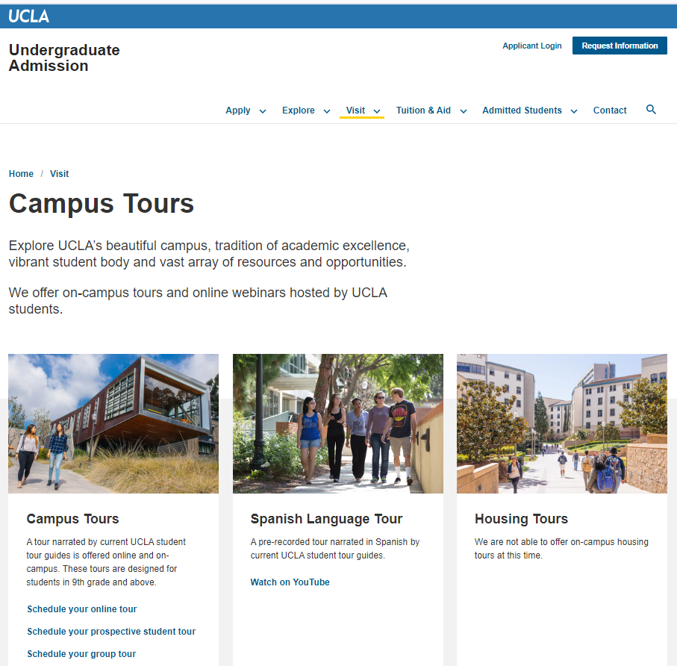
How to Create a College-Going Culture: Knowledge & Inspire Youth to Go to College
Attend college tours, college fairs or college events
Connect youth to foster care alumni who are enrolled in college
Explain the differences between college and high school
Discuss the long-term financial benefits
Discuss the non-academic benefits of college
Virtual or in-person tours
Notes:
In addition to motivating and encouraging youth, it’s also important that they build their knowledge and awareness about college and know what to expect. Here are some activities that caregivers can do with youth:
Expose youth to a college campus but having them attend college tours. This can be a great activity to do together and helps the student get familiar with a college campus. If you aren’t able to take a student on an in-person tour, you can visit a college website together. Many now have interactive virtual tours and videos.
Another creative way to expose youth to college is to bring them to college events that they will be interested in, such as sporting or performing arts events and activities
Connect youth to foster care alumni who are enrolled in college. One way to do this is by connecting with your local community college and their foster youth campus-support program. We’ll share later on how you can find the contact information for these programs.
Explain how college is different from high school. This is particularly important for youth who didn’t like high school to understand the differences. For example, college has flexible schedules and students can pick classes in the morning, afternoon or evening. In addition, students can choose their own classes based on their educational and career goals, and there is a much wider range of course options (including vocational training). In addition, for students who don’t like a traditional schedule, many colleges now offer online classes or hybrid options. An overview of these differences can be found in the postsecondary education planning guide.
Tell youth about the statistics from the earlier slides that demonstrates income differentials between a high school diploma vs. a college education. For some youth, money can be a motivator!
Caregivers can also talk to youth about the other non-academic benefits of higher education, such as more career options, higher employment rates, opportunities to develop critical thinking and communication skills, meet new friends and develop connections. For many people, college can be fun!

Slide 39
How to Create a College-Going Culture:
Keep Youth Accountable
Regularly ask how they are doing in school.
Instead of asking “How was school?”, ask specifics like “What did you learn in class today?” or “How did you feel about the math exam?”
Check for homework completion and grades
Provide incentives or rewards for positive school performance academically or behaviorally.
Notes:
It is equally important to hold youth accountable to agreed-upon expectations.
Caregivers should frequently ask about school and check grades, check for homework completion, follow-up on tasks related to education, or use texting to send reminders about tasks.
When asking about how a student is doing in school, use open-ended questions. Instead of asking, “how was school?”, ask specifics like “what did you learn in class today?” or “How did you feel about the math exam?”
Caregivers can also display positive grades or rewards at home.
They should also be thinking creatively about incentives. Caregivers can explore rewards, such as special outings or activities, that relate directly to the goals set. Get creative as the incentive doesn’t have to be a gift.
This reward or incentive may be for positive performance or improvement academically or behaviorally related to education. This connects back to encouraging a growth mindset. Caregivers should use Reasonable and Prudent Parent standards to determine the most appropriate incentive.

Slide 40
Student
Voices
Motivating youth in care to attend college and helping them to overcome obstacles can make a difference.
Notes:
Motivating youth in care to attend college and helping them to overcome obstacles can make a difference. Let’s hear from our youth again.
Trainer’s Note:
Click on the text box to be directed to the link with the video. NOTE: Many YouTube videos have advertisements that will play before the video. Check the Trainer’s Guide for some tips and tricks on how to set up these linked videos.

Slide 41
Summary of Key Ways That Caregivers Can Support Youth Into Higher Education
Use a trauma-informed parenting approach
Encourage a growth mindset
Use a “PACE” Attitude
Create a college-going culture by:
Encouraging & motivating youth
Building their college-knowledge
Keeping youth accountable
Notes:
To summarize what we just discussed, here are some key strategies that caregivers can support youth into higher education:
Use a trauma-informed parenting approach, remembering that many youth are in “survival mode”
Encourage a growth mindset
Use a “PACE” Attitude when engaging with youth- Playfulness, Acceptance, Curiosity and Empathy
Create a college-going culture by:
Encouraging & motivating youth
Building their college-knowledge, and
Keeping youth accountable
**Trainer’s Note- Interaction Opportunity (4-5 minutes):
To encourage peer learning, ask the audience if there are any strategies that they have implemented and found successful to create a college-going culture in the home. This can be facilitated either in-person or via Zoom. Participants can either unmute themselves or write a response in the chat if via Zoom, or simply have attendees raise their hand if in-person.

Slide 42
Time for a break!
Notes:
Trainer’s Note: Allow participants a 10-minute break. This can be taken all at once or spread out as two 5-minute breaks or adjusted depending on time.

Slide 43
Understanding available higher education options
Postsecondary Pathways for Everyone
Notes:
The term “college” can mean a lot of things. While the common college experience portrayed in the media is that of a first-time college freshmen enrolling directly at a four-year university, there are in fact many more paths available.
Foster youth should be empowered with information about these various paths so that they can make the choice that is best for them.

Slide 44
Educational Pathways
Notes:
Here is an overview of the various postsecondary education pathways.
One pathway is that of a student with a high school diploma going directly into a 4-year college or university. This can either be a public 4-year university or college, such as the University of California (UC) System or Cal State University (CSU) system, or an accredited in state or out of state private college or university such as University of Southern California (USC) or Howard University.
Community College Pathway
Another pathway may include a student with either a high school diploma equivalent attending a community college or junior college.
Community colleges offer a wide variety of postsecondary programs in career education (e.g., dental hygiene, culinary arts, business administration, veterinary technician) as well as majors for transfer to a 4-year university.
Career Technical Programs
While the community colleges offer a wide away of career education programs, there are also other options for career technical programs through Adult Education, Job Corps and apprenticeships.
We will talk more about these options in a moment.
Trainers Note: The information in the Postsecondary Educational Planning Guides for Foster Youth provides more information on the various pathways available to foster youth.

Slide 45
Difference Across Colleges and Universities
 | University of California (UC) or California State University (CSU) | Private University | Out-of-State Universities | California Community College (CCC)
Admissions Requirements | Selective admissions: A-G Requirements Academic GPA Personal Statement (UC Only) SAT/ACT no longer required | Selective admissions: A-G Requirements Academic GPA Personal Statement May require SAT/ACT May request Letters of Recommendation | Selective admissions: A-G Requirements Academic GPA May request a Personal Statement May require SAT/ACT May request Letters of Recommendation | Open access colleges: HS Diploma not required No minimum GPA No personal statement No SAT/ACT required
 | University of California (UC) or California State University (CSU) | California Community College (CCC) | Out-of-State Universities | Private University
Admissions | Selective admissions: A-G Requirements Academic GPA Personal Statement (UC Only) SAT/ACT no longer required | Open access colleges: HS Diploma not required No minimum GPA No personal statement No SAT/ACT required | Selective admissions: A-G Requirements Academic GPA May request a Personal Statement May require SAT/ACT May request Letters of Recommendation | Selective admissions: A-G Requirements Academic GPA Personal Statement May require SAT/ACT May request Letters of Recommendation
Notes:
Note: The complete chart is broken down into three slides
Each Postsecondary system is a little different in their admission requirements, room and board options and degrees offered. It’s important to connect with your student’s academic counselor to help ensure your student is enrolled in the right courses for their intended postsecondary journey.
Let’s start by reviewing the differences in admission requirements:
Public 4-year universities and most private colleges have a selective admissions process. UCs and CSUs, Out of State and Private College and Universities will typically require completion A-G courses in high school. It is best to check with the student’s academic counselor to ensure that the student is enrolled in the appropriate A-G courses and passes with a grade of C or better.
What are “A-G” courses? The CSU’s and UC’s require the college preparatory pattern of classes referred to as the “a-g” courses for admission.
There are specific requirements for each subject, such as math, English, history, and science. See the Educational Planning Guide to learn more about the specific requirements for each category to ensure that students who may be interested in a 4-year pathway are enrolled into these courses. It’s not just about making sure that a student is enrolled in high school, but that they are enrolled into the right courses to have a 4-year college pathway as an option.
While the SAT and ACT are no longer required for the UC or CSU systems, some private and out of state universities may still require students to complete the exam. Opportunities to take the PSAT begin as early as 10th grade.
Out of state and private institutions may also request two or more letters of recommendation.
On the other hand, community colleges typically have no minimum GPA requirements, qualifying admissions tests, or essays. This is why they are referred to as open access institutions.
Though community colleges do not require a diploma or equivalency to register, a high school diploma or equivalency is strongly recommended as it is required for federal and state financial aid eligibility.
Trainer’s Note:
Animation is built into each section. To make this slide more engaging, facilitators can prompt the audience to share what they know about the admissions requirements for each type of college and university to test their knowledge. After they respond the trainer can display the correct information and note if there is any content that they missed. The audience can be engaged in-person by simply raising their hands or calling out responses. Virtually, attendees can also raise their hand, come off mute or write responses in the chat. Please note that engaging the audience does add time to the slide.

Slide 46
Difference Across Colleges and Universities
 | University of California (UC) or California State University (CSU) | California Community College (CCC) | Out-of-State Universities | Private University
Admissions | Selective admissions: A-G Requirements Academic GPA Personal Statement (UC Only) SAT/ACT no longer required | Open access colleges: HS Diploma not required No minimum GPA No personal statement No SAT/ACT required | Selective admissions: A-G Requirements Academic GPA May request a Personal Statement May require SAT/ACT May request Letters of Recommendation | Selective admissions: A-G Requirements Academic GPA Personal Statement May require SAT/ACT May request Letters of Recommendation
 | University of California (UC) or California State University (CSU) | Private University | Out-of-State Universities | California Community College (CCC)
Admissions Requirements | Selective admissions: A-G Requirements Academic GPA Personal Statement (UC Only) SAT/ACT no longer required | Selective admissions: A-G Requirements Academic GPA Personal Statement May require SAT/ACT May request Letters of Recommendation | Selective admissions: A-G Requirements Academic GPA May request a Personal Statement May require SAT/ACT May request Letters of Recommendation | Open access colleges: HS Diploma not required No minimum GPA No personal statement No SAT/ACT required
Room & Board | Priority access to campus housing Access to meal plans | Access to campus housing Access to meal plans | Access to campus housing Access to meal plans | Campus housing and meal plans are not typically available
Notes:
Room and Board
Public 4-year universities and, in most cases, private colleges offer on-campus housing. In contrast, community colleges do not generally have housing available, except for a small number of campuses that do offer housing.
Current and former foster youth who were in care at age 13 have access to priority housing within the UC and CSU systems.
Students who receive campus housing will also be asked to select a meal plan for on-campus dining. Students can choose the meal plan that best fits their budget and dietary needs.
Community Colleges host a number of restaurants and campus food vendors but do not provide a meal plan for students.

Slide 47
Difference Across Colleges and Universities
 | University of California (UC) or California State University (CSU) | Private University | Out-of-State Universities | California Community College (CCC)
Admissions Requirements | Selective admissions: A-G Requirements Academic GPA Personal Statement (UC Only) SAT/ACT no longer required | Selective admissions: A-G Requirements Academic GPA Personal Statement May require SAT/ACT May request Letters of Recommendation | Selective admissions: A-G Requirements Academic GPA May request a Personal Statement May require SAT/ACT May request Letters of Recommendation | Open access colleges: HS Diploma not required No minimum GPA No personal statement No SAT/ACT required
Room & Board | Priority access to campus housing Access to meal plans | Access to campus housing Access to meal plans | Access to campus housing Access to meal plans | Campus housing and meal plans are not typically available
Degrees Offered | Bachelors (Arts or Sciences) Masters Doctorate | Bachelors (Arts or Sciences) Masters Doctorate | Bachelors (Arts or Sciences) Masters Doctorate | Certificate Associate Degree Associate Degree for Transfer (ADT) Limited bachelors programs
Notes:
Degrees Offered
Four-year institutions like UCs, CSUs and private universities offer bachelor degrees across a number of areas from the liberal arts (English, Art History, Languages) to the social sciences (psychology, anthropology, sociology), sciences and technology (computer science, chemistry, math, engineering) among many others.
The UCs, CSUs and private universities will also host a number of advanced degrees such as masters in business administration, masters in social work, masters in educational counseling as well as doctoral programs.
Community colleges provide students access to career education certificates and associate degrees that students can use to complete transfer and continue towards their bachelor’s degree. Community colleges also have transfer agreements with CSUs and UCs as well as Historically Black Colleges and Universities. Students can begin their postsecondary journey at their local community college and transfer anywhere!
There are more than 20 community colleges who have been approved by the state to offer a bachelor’s degree in an area of study that is not available within the CSU or UC system. For a full list of campuses that host a bachelors degree program, visit: https://icangotocollege.com/bachelors-degree-program#allprograms
Some examples include (NOTE: Read off only two that seem in closest proximity to your audience)
Cypress College - Mortuary Science
San Diego Mesa - Health Information Management
Santa Monica - Interaction Design
Skyline - Respiratory Care
West Los Angeles - Dental Hygiene
Trainer’s Note:
Animation is built into each section. To make this slide more engaging, facilitators can prompt the audience to share what they know about the “Degrees Offered“ for each type of college and university to test their knowledge. After they respond the trainer can display the correct information and note if there is any content that they missed. The audience can be engaged in-person by simply raising their hands or calling out responses. Virtually, attendees can also raise their hand, come off mute or write responses in the chat. Please note that engaging the audience does add time to the slide.

Slide 48
Career & Technical Education (CTE)
Can be shorter programs (ex: 12 - 18 months)
High-quality, career-focused programs leading to good-paying jobs
Financial aid is available
Many are offered at community colleges, which foster youth can often attend for free
Earn a Plumbing Technology certificate at L.A. Trade Tech Community College and make $60,000!
Notes:
Students who are interested in career education have a number of options available to them. It is important to take the time to explore each one to see which best meets the student’s needs and supports their long-term career goals.
Career & Technical Education (also known as CTE), provides high-quality, targeted, career-focused training that can lead to direct entry into the workplace.
Students can get training in a range of fields. Examples of some of these jobs include becoming a website developer, dental hygienist, diagnostic medical sonographer, cosmetologist, esthetician, or construction site inspector. Program offerings may vary by campus.
CTE are often shorter-term programs, sometimes only 12-18 months, leading to a certificate.
Many of these jobs offer good salaries in high-demand fields, with growth opportunities. For example, a student can get a certificate in Plumbing at LA Trade Tech College and make $60,000.
They provide high-quality, targeted, career-focused training that can lead to direct entry into the workplace.
Financial aid is available for many CTE programs as well.
It is important to remember that many current and former foster youth can qualify for free tuition at most California community colleges and they can receive around $30,000 in free state and federal grants. This is free money that does not need to be paid back and can be used for tuition, books, rent, transportation and other expenses while students work on completing their program.
NOTE: Information about the various career education pathways and links to where to find more details for each are available in the Foster Youth Postsecondary Education Planning Guide. Additional information can also be found at the sites listed below.
California Community College: To learn which community college hosts programs of interest, visit: https://www.cccco.edu/Students/Find-a-College

Slide 49
Adult Education Programs
Military
Service
Job Corp
Offers a wide variety of accredited career education programs
Units do not transfer towards a college degree
Eligible for federal financial aid
Free career education with housing and basic living allowance.
No minimum GPA or high school diploma/equivalent required
Age, income, and citizenship restrictions.
Access to housing resources, basic living allowance, and educational benefits.
Is a full-time job with a multiyear commitment
Notes:
Adult Education
While there are robust CTE programs at our community colleges, there are also programs available through Adult Education Programs and Job Corps.
Adult Education Programs provide a number of career technical programs that vary from district to district. Financial aid can help cover expenses of these tuition-based programs. The programs are similar to those offered through the community colleges, but units complete through these programs will not transfer towards a college degree. Potential career pathways include fields like medical assisting, culinary arts, construction, phlebotomy and others.
Job Corp
Job Corps is a free residential education and job training program administered by the US department of labor in which students receive a basic living allowance alongside their career education.
Job Corps programs offer a great opportunity to learn career skills, ranging from construction to water management to office administration while providing life skills in a supportive environment.
Job Corp does not require a minimum GPA or a high school diploma. Because this is a federally administered program, there are eligibility requirements around age, income and citizenship.
Military Service
Some students may be interested in enlisting in a branch of the military to access housing resources and a basic living allowance along with educational benefits. It is important to remind student that the military is a full-time job that includes an educational component and a multiyear commitment.
NOTE: Information about the various career education pathways and links to where to find more details for each are available in the Foster Youth Postsecondary Education Planning Guide. Additional information can also be found at the sites listed below.
California Adult Education Programs: Go to https://caladulted.org/Students to learn more. To find a nearby program, visit https://caladulted.org/FindASchool
Job Corps: To learn more, visit https://www.jobcorps.gov/

Slide 50
Apprenticeship Programs
Most apprentices retain employment after completing the apprenticeship
Students earn an income while learning a trade
Participants receive industry recognized credentials and can work towards a degree
Students connect with mentors in a chosen industry
Some programs may require an aptitude test and most require English proficiency
Learn more about apprenticeship programs by visiting:
www.dir.ca.gov/das/das.html
Average annual income is $50,000!
Notes:
Apprenticeship programs present another pathway for students to access postsecondary opportunities.
California provides apprenticeship programs that prepare students to enter skilled positions across various sectors including masonry, carpentry, solar installation, construction, cosmetology and others. Most individuals who complete an apprenticeship program retain employment after their apprenticeship end.
The average income for an individual who completes an apprenticeship is $50,000 – and students can begin earning while working to develop their skills.
Educational and other eligibility requirements may vary. Some programs prefer applicants with a high school diploma or equivalent, some may require aptitude or other testing and others may have more rigorous standards.
More information on the apprenticeship programs available in your area can be found by visiting the link on the slide: https://www.dir.ca.gov/das/das.html

Slide 51
WARNING!
Proprietary or For-Profit (Private) Vocational Schools
Costs more than similar community college programs
High rates of student debt
Poor job outcomes
Some are under federal investigation
Use extreme caution before enrolling and ensure the school is accredited
Notes:
All schools promote themselves on the internet, so it can be hard to determine which are legitimate and which are not. It’s important to make sure that any educational institution your student is interested in is accredited; that there is solid proof that graduates receive certification in their trade; and the school offers support for job placement, with a good success rate. Degrees from nonaccredited colleges are a waste of time and tuition.
For-profit schools tend to cost significantly more than public schools, which leads to higher debt that students struggle to repay and do not necessarily lead to favorable employment outcomes, or wage gains. Oftentimes, units at these schools rarely transfer. One example was ITT Technical Institute, which shut down after multiple lawsuits alleging fraud.
These proprietary schools may employ aggressive recruitment and marketing strategies to attract students. As caregivers, it’s important that you support your youth in researching the programs they are interested in and are aware of all their options before enrolling, especially to prevent unnecessary debt.
Remember, the community colleges offer a wide range of vocational, or CTE, programs that are free or low-cost to youth in foster care.
Trainer’s Note: One tip for foster youth who are interested in vocational education and considering a program outside of a community college is to consult the California Student Aid Commission website for a list of schools that are approved for use of Cal Grant dollars as these institutions have demonstrated more favorable employment outcomes. The link offers an annual list of eligible and ineligible schools: https://www.csac.ca.gov/post/cal-grant-eligible-school-list-0. There is also the Database of Accredited Postsecondary Institutions and Programs: https://ope.ed.gov/dapip/#/home which lists information on accredited institutions. Both resources are available in the Foster Youth Postsecondary Education Planning Guide resources section.

Slide 52
Resources on college and
career exploration
Notes:
Now that you are familiar with the different college pathways, how can caregivers help youth determine which pathway is best for them?
It depends on the youth’s educational goals, career interests, learning styles, and other preferences. No one pathway is inherently better than the others. While not always possible, it’s ideal to first help youth identify a career interest, then find the appropriate major or certificate to match that interest, and then help them determine which institutions offer those programs.
Keep in mind though, that it is not always a linear path and this is a conversation that caregivers will want to start early and regularly revisit with youth as their interests and goals will likely change over time.

Slide 53
Engaging Youth in Career Exploration
LA Opportunity Youth Collaborative
Youth Career Guide & Caregiver Companion Guide at laoyc.org/guides
Career Conversation Starters:
Do you find it easy or difficult to think about yourself in the future? What might make it easier?
What are some of your talents/skills/strengths (try to think of 3-5)?
How would your best friend describe you?
What is one thing that makes you excited about your future? Makes you worry about your future?
What careers or jobs have you heard about? Which ones would you like to know more about?
What are some activities you enjoy doing in your down time?
Career Activities:
www.cccmypath.org
www.myplan.org
www.cacareerzone.org
www.gladeo.org
Notes:
When caregivers begin with first exploring a youth's interests, it will increase the youth’s motivation and provide meaning to stay engaged in school.
It also decreases the likelihood of choosing the wrong degree path, which can result in students spending unnecessary time and money.
Taking an interest in your youth and listening to their interests also makes youth feel like they matter and that they are valued.
Most youth at this age are still learning more about themselves. By helping a youth better understand their strengths and interests, you can help build connections to careers that match their strengths.
While it may be difficult for a youth to know what career they may be interested in exploring, there are other ways to engage youth in career exploration. Conversation starters like the ones on the screen can also be found in the Foster Youth Postsecondary Planning Guide.
Additionally, there are many great tools and resources available to caregivers to engage with youth. Various online tools hosts activities to help youth find a meaningful career.
There is also a Youth Career Guides, and companion Caregiver Guide created by the LA Opportunity Youth Collaborative to provide caregivers with concrete activities to do with youth. The guide is available for download in English and Spanish at laoyc.org/guides/
Trainer’s Note: The online career tools can also be located in the Foster Youth Postsecondary Planning Guide located on the JBAY website: https://jbay.org/resources/ed-planning-guide/

Slide 54
Reality Testing
When engaging in Career Exploration,
youth must consider the following:
Earnings vs. cost of living and lifestyle needs
Education requirements and costs
Projected industry growth
livingwage.mit.edu
www.cacareerzone.org/budget/
salarysurfer.cccco.edu
Learn what the cost of living is in your community & what you need to earn using the Living Wage Calculator.
Customize your lifestyle to determine how much you will need to earn based on your preferences.
Explore the real earnings of California Community College graduates by program type
Notes:
When engaging in Career Exploration, youth must consider the following:
-Earnings vs. cost of living and lifestyle needs
-Education requirements and costs, and
-Projected industry growth
These tools can help youth understand the cost of living in their community and how much money they will need to make to be able to afford the type of lifestyle that they want. For example, is getting your nails done a need or a want?
They can also help expose youth to new possibilities. For many foster youth, the only careers they may have been exposed to are social workers, teachers and police officers.
Here’s what these tools can do:
The Living Wage Calculator identifies the cost of living in your particular city.
Doing the budget on CA Career Zone can help you to engage in a meaningful conversation with youth about their basic needs and determine the type of jobs or careers that they would need to afford the lifestyle that they want, and then backwards plan to determine the type of education necessary to reach that goal.
Salary surfer can show the real earnings of California Community College graduates and also help youth learn about the wide range of pathways available to them.
**Trainer’s Note- Interactive Opportunity (10 minutes):
Allow attendees to explore some of these websites to get more comfortable with these tools.
In-person: Have people get into pairs and pick a website to do on their smart phone. One person can pretend they are the caregiver and the other can respond to the questions as if they are the youth.
Via Zoom: Randomly put people into breakout rooms of two people. Have one person pick a website and share their screen. They can pretend they are the caregiver and the other attendees can pretend that they are the youth responding to the questions or information.

Slide 55
Navigating Reality Testing Conversations
Use storytelling or personal anecdotes
Stick to the facts
Question vs. Advice
Notes:
Here are some tips of ways to navigate the conversation about reality testing with youth.
As a caregiver, you can use storytelling or personal anecdotes about your own job or career experience. I’m sure most of us adults started off in customer service as their first job (i.e. McDonalds, JCPenny’s, Baskin Robbins). Most of us don’t just land in the jobs we have now, we have worked through a career path to get where we are today.
It’s important to teach youth that these customer service jobs teach us skills that are translatable to help us be successful in our careers. For example, maybe you got fired from your first job because you didn’t realize that being late on the time clock for 3-minutes was a big deal and you were late multiple times. Many youth may be surprised to learn that. These conversations are key to help normalize these experiences.
When possible, stick to facts instead of perceptions. Use this as an opportunity to provide youth with information about the costs of living, higher education or projected industry growth to help inform but not dictate their decision-making process. “Just because I told you so” usually isn’t an effective strategy with a teenager.
Lastly, ask youth questions instead of giving them advice. What if you give them advice and it doesn’t work? Ask youth questions about what they want to do and help them decide the right decisions for them. Refer back to the PACE attitude to help them make those decisions, using empathy and curiosity, to support them through the process.

Slide 56
Goal Setting
Include short- and long-term goals
Explore potential barriers
Discuss what will motivate youth to keep going
Identifying supports at each stage
Notes:
Caregivers should also assist youth in goal setting. These should include both short- and long-term goals. Long terms doesn’t need to mean where they see themselves in 10 years. A long-term goal could be something that they hope to achieve throughout their school year, and a short-term goal can be focused on the day or week ahead.
Their goals can also be related to other things beyond education that might impact their long-term career goals, such as participating in therapy or practicing soccer daily so that they can make the high school team.
It’s natural and normal to expect bumps and challenges along the way. Explore with youth what will motivate them and help them keep going even when times may be tough. You might ask, “What are things that I can do to help you stay motivated if there are bumps along the way?”
Lastly, help the youth identify supports at each stage in the process. When youth are in flight or fight mode, they may have a hard time remembering who to ask for help.

Slide 57
Education Planning Milestones
Helping foster youth chart a course to their college pathway.
Notes:
As mentioned before, there are many pathways to higher education.
This can include career and technical education, an associate’s degree or a bachelor’s degree.
Which type of higher education is right for your youth will depend not only on their interests and goals, but also on their educational path in middle school and high school.
Depending on the path that the youth chooses, there are various educational planning milestones for each grade that are necessary along the way to ensure that they reach their educational goal successfully.

Slide 58
Helpful Tip!
Every youth is different.
Meet youth where they are at.
Notes:
Before delving into the steps to prepare a youth for postsecondary education, we need to keep in mind that, for many children who have been in care, their developmental or emotional age isn’t necessarily the same as their chronological age and grade level, and some steps may need to be adjusted.
Caregivers will need to meet their kids where they are. Some kids may need more guided support to meet their goals and/or more time to get there.

Slide 59
Educational Planning Milestones: Grade 6-8
See Foster Youth Postsecondary Education Planning Guide for more information
Meet with academic counselor
Maintain regular attendance
Seek tutoring as needed
Build career awareness through extracurriculars, electives and more!
Notes:
The goal is that, by the end of middle school, youth will have developed the necessary skills—like time management, study habits, maintaining regular attendance, and test-taking techniques—to succeed in high school. We are providing more on how caregivers can encourage youth to develop these skills in the Foster Youth Postsecondary Guide.
To achieve this goal in middle school, youth first need to feel comfortable at school. Caregivers can help their youth by regularly meeting with school counselors to stay connected to their child’s progress. Middle school is also a great time for youth to do early career exploration. A variety of options for exploring careers are available, depending on the emotional age and interests of the youth. This can include participating in extracurriculars, elective classes or participating in career awareness activities, such as job shadowing or career fairs. As mentioned earlier, caregivers can spend time with their child by visiting educational websites specifically dedicated to their interests and exploring careers around those interests.
I also strongly suggest that caregivers attend any education planning nights with their middle schooler, where local high school counselors present their programs and schedules.
It is also helpful for youth to start a binder to keep in one place all of the information related to postsecondary education. This can include copies of test scores, grades, lists of extracurricular or volunteer activities, as well as log-in names and passwords for college-related websites.

Slide 60
Educational Planning Milestones: Grade 9
Enroll in “A-G” courses
Visit a college campus
Join an academic enrichment program
Meet with academic counselor
Maintain regular attendance
Seek tutoring as needed
Build career awareness through extracurriculars, electives and more!
Notes:
Once in high school, it is important that the student continues to build upon these middle school foundations. It’s particularly important to meet with their school counselor every semester to not only make sure that they are on track to graduate, but to also make sure that they are in the right courses depending on their college and career interests.
Some counselors and teachers who are not aware of the impact of trauma on youth in care may not realize a youth’s full potential. Thus, caregivers need to be supportive and continue to advocate for their youth.
An additional benefit of these meetings is that they demonstrate to both the youth and counselor that the caregiver cares, which encourages youth to stay on track to graduate.
The new milestones for 9th grade are shown in yellow.
What are “A-G” courses? The CSU’s and UC’s require the college preparatory pattern of classes referred to as the “a-g” courses for admission.
There are specific requirements for each subject, such as math, English, history, and science. See the Educational Planning Guide to learn more about the specific requirements for each category to ensure that students who may be interested in a 4-year pathway are enrolled into these courses. It’s not just about making sure that a student is enrolled in high school, but that they are enrolled into the right courses to have a 4-year college pathway as an option.
College tours can occur in 9th grade or even in middle school. It’s recommended that students have multiple opportunities to attend college tours or college fairs.
In addition to college tours occurring at the student’s high school, there may be other foster-youth specific college tours occurring through ILP and local non-profits.
Lastly, many high schools offer academic enrichment programs and students should be encouraged to participate. Enrichment programs are considered to be any productive experiences extending beyond the traditional school curriculum that encourage academic performance and college attendance. They can be offered during the school year or during the summer. It is a good idea for students to play an active role in finding programs that will fit their interests and goals. A guidance counselor can help students identify local programs. There are even some programs specific just to foster youth. A list of foster youth-specific academic enrichment programs in LA County can be found in the LA County College Planning Resources Handout in your caregiver materials. (LA relevant content only)
Trainer’s Note: Learn about any resources or events for foster youth in your local community to share with the audience. Ask the foster-youth support program at your community college if they have any resources or events to share.

Slide 61
Educational Planning Milestones: Grade 10
Enroll in dual enrollment courses
Find a summer job or internship
Take any practice tests like the PSAT
Enroll in “A-G” courses
Visit a college campus
Join an academic enrichment program
Meet with academic counselor
Maintain regular attendance
Seek tutoring as needed
Build career awareness through extracurriculars, electives and more!
Notes:
In 10th grade, students should continue to maintain the middle school and 9th grade milestones, including ongoing enrollment in “a-g” courses, visiting college campuses, and enrolling in academic enrichment programs.
Some youth should also consider concurrent or “dual enrollment” courses, which are courses that count for both high school and college credit. These are often offered at the local community college or directly on a high school campus. They are a great way for students to get early exposure to the college environment. They are actually proven to help increase high school graduation and college enrollment and completion rates. The benefits extend to low-income students, students of color and those with lower GPA’s.
There are dual enrollment programs that offer career pathways, enrichment activities, academic support, and textbook loan assistance.
Sometimes people think that taking college courses in high school is only for students with a high GPA or who are in honors classes. In fact, dual enrollment is available to anyone and sometimes students who struggle in high school classes are more engaged in a college level class that speaks to their interests
Taking these courses can give them a head start towards an Associates Degree and even a Bachelor’s degree.
In addition to the career exploration activities shared for middle school and high school, summer is a great opportunity to find a summer job or internship. These experiences will help a youth in care develop workforce readiness skills and explore career interests and strengths. Caregivers should assist youth in this search process ahead of time.
Those 10th graders who have expressed any interest in attending a 4-year university should also consider taking any practice college entrance tests, such as the PSAT. Often, fee waivers are available for youth in care through their high school counselor. If students don’t take a practice test in the 10th grade, they can take it in the 11th grade. The more practice, the better! While these exams are no longer required by the UCs or CSUs for purposes of admission, they may still be required by both in-state and out-of-state private universities.
Trainer’s Note:
If asked, PSAT stands for Practice Scholastic Assessment Test and ACT stands for the American College Test.

Slide 62
Financial Aid Guide for California Foster and Unaccompanied Homeless Youth
Use the Financial Aid Guide for step-by-step information on completing the financial aid applications, what to do after they apply to ensure maximum financial aid awards, and how to stay in good standing and keep getting financial assistance for school
Available at: www.jbay.org/resources/financial-aid-guide/
Notes:
Although students pursuing higher education won’t need to apply for financial aid until their senior, 10th grade is a good time to become familiar with the financial aid process. This process doesn’t have to be intimidating and confusing.
The student-friendly Financial Aid Guide for California Foster and Unaccompanied Homeless Youth takes the mystery out of applying for and keeping financial aid.
This comprehensive guide begins with an explanation of different types of financial aid available, includes a step-wise guide to completing financial aid applications, tips on what to do after students apply for financial aid to ensure maximum aid awards, and explains how to stay in good standing and keep getting financial assistance for school.
When the time is right for your student, this guide can be an excellent resource for both students and caregivers.
It can be found in the link above and also in your Caregiver Materials section.
Trainer’s Note: This guide is available in English and Spanish. It can be viewed and downloaded with the caregiver materials at:
www.jbay.org/resources/edcourse1-caregiver-supporting-materials/

Slide 63
Student
Voices
Tips for caregivers from youth.
Notes:
Before we move on, let’s listen to our youth about who provided them with the skills they needed to succeed. Additionally, many had tips for caregivers. Let’s take a minute to hear their thoughts.
Trainer’s Note:
Click on the text box to be directed to the link with the video. Click on the text box to be directed to the link with the video. NOTE: Many YouTube videos have advertisements that will play before the video. Check the Trainer’s Guide for some tips and tricks on how to set up these linked videos.

Slide 64
Help is Available for Caregivers
Notes:
I know planning and preparing for college can be complicated, even for the most organized family.
The good news though is that there are a range of resources and supports to assist caregivers and youth throughout this process available at both the school districts and child welfare.
See the Resources section of the postsecondary education planning guide for an overview of resources found across K-12 education, child welfare and higher education.

Slide 65
— 61
Help is Available at the K-12 Districts
Academic Counselors
Foster Youth District Liaison (AB 490 Liaison)
County Office of Education Foster Youth Services Coordinating Program (FYSCP)
Notes:
Here are a few resources available at the K-12 districts.
The academic counselor can assist to make sure that the student is taking the right courses to reach their goals and is on track to graduate. They can also assist a foster youth to obtain a fee waiver for placement exams and connect the youth to other resources such as academic enrichment programs or tutoring, available through the district.
The Foster Youth District Liaison (also known as the AB 490 Liaison) can be found at every district. They can help collect transcripts from different schools, assist students to obtain partial credits to stay on track for graduation, identify tutoring resources at the district and in the community, and assist with determinations for AB 167/216 (which are graduation exception requirements for foster youth). Your district liaison information can be located at https://www.cde.ca.gov/ls/pf/fy/ab490contacts.asp.
Lastly, another great resource is the County Office of Education Foster Youth Services Coordinating Program (FYSCP). The link to locate information on your county’s program can be found on the slide, which also includes the contact information. Some of the services include technical assistance to the districts, professional development training for school districts, child welfare, probation, and caregivers, tutoring, educational case management and transition to college and career services. COE FYSCP Counselors may also be able to assist by attending team meetings and advocating for students upon request. Reach out to your local County Office of Education FYSCP Counselor for assistance: www.cde.ca.gov/ls/pf/fy/
Trainer’s Note:
Further information about AB 167/216 can be found in the handout provided earlier that is created by the Alliance for Children’s Rights.
This slide should be updated with the correct name, website, and contact information for your local COE FYSCP. While all COE FYSCP provide the same general services, there is regional variation on services and structure. Therefore, it is recommended that you contact your local COE FYSCP to determine the best language to include in this slide. Contact information for each county can be found here: www.cde.ca.gov/ls/pf/fy/
In addition, facilitators are encouraged to include their own regional handout of local programs and resources. A sample of what this resource could include is available in the LA County College Planning Resource Guide handout located on the JBAY website at https://jbayorg.wpengine.com/wp-content/uploads/2021/07/LA-County-resources-2.pdf
**Los Angeles County Trainers may want to facilitate information for the following:
Los Angeles County Office of Education Foster Youth Support Coordinating Program: https://www.lacoe.edu/services/student-support/foster-youth-services
LAUSD Student Support Services Division: https://achieve.lausd.net/studentsupportprograms

Slide 66
Independent Living Program (ILP)
Youth suitably placed in foster care or Kin-Gap between the ages of 16-18 may be eligible to receive ILP services. Please contact an ILP Transition Coordinator to determine eligibility.
ILP provides services related to postsecondary education, workforce development and housing.
Contact an ILP Transition Coordinator to learn more regarding resources and services available.
Visit https://jbay.org/resources/ilp-roster/ for ILP contact information by county.
Notes:
The Independent Living Program (often called ILP) is a voluntary program offered through the child welfare and probation department. It provides services and funding to help youth gain the skills necessary to live independently.
Youth who were suitably placed in foster care or Kin-Gap at any time between the ages of 16-18 can request an ILP Transition Coordinator to assist the youth until they are 21. Determining eligibility for this program can sometimes be complex, so please refer any eligibility questions to your ILP Transition Coordinator.
If you cannot locate their contact information on the county website, ask your social worker or Probation officer for assistance.
Each county provides an array of services. Check with your ILP Coordinator to learn more about what services are available for youth in your county.
Lastly, the ILP Coordinator can serve as a supportive adult in the life of a young person to assist them in their journey towards self-sufficiency.
Trainer’s Note: Determining ILP eligibility can sometimes be complex. Please refer any eligibility questions directly to ILP.
This slide can be updated with the correct contact information for your local Independent Living Program. While all ILP’s provide the same general services and have the same eligibility criteria, there is regional variation on services and structure. Therefore, it is recommended that you contact your local ILP to determine the best language to include in this slide. JBAY maintains a roster of ILP Coordinators for each county which can be found here: https://jbay.org/resources/ilp-roster/
**LA Trainers: Please share ILPonline.org with audience members to learn more about the benefits available to ILP eligible foster youth in Los Angeles County.

Slide 67
Child and Family Team Meeting (CFTM)
The CFTM can be used to make a plan to support foster youth in reaching their college and career goals and get connected to supports and resources.
Notes:
While this training is designed to equip caregivers to support youth on their higher education journey, we also know that it takes a village and that caregivers are part of a team.
The Child and Family Team Meeting (CFTM) can be used to make a plan to support foster youth in reaching their college and career goals and get connected to the appropriate supports and resources.
CFTMs don’t always have to be focused on a crisis or immediate need, but can also be requested to proactively discuss the youth’s academic performance as well as their progress towards their long-term goals and overall well-being.
Discussing the youth’s interests, goals and the key educational planning milestones for 6th-10th grade can be great topics to explore at these meetings.
In addition, it’s encouraged that educational partners are invited to attend the CFTM, and it can even be hosted at a school site to accommodate school staff, if the youth is comfortable.

Slide 68
www.cacollegepathways.org
Notes:
Lastly, this website includes a range of resources and information for foster youth and adult supporters about higher education. It also includes a search tool to find campus-based support programs at California’s colleges and universities and their staff’s contact information.

Slide 69
College is Possible
Regardless of current academic performance, grades, behaviors or income.
Notes:
In the beginning of this training, we asked you to reflect on any concerns or fears you may have about your youth attending college. Just like you, youth themselves may have their own fears or concerns about attending college. The good news is that there are a lot of resources and supports available to assist youth in their higher education journey.
Regardless of current academic performance, behaviors, grade or income, college is still possible!

Slide 70
Fact or Fiction?
Foster youth qualify for a lot of financial aid to assist with the costs of college.
FACT!
Notes:
Fact- Foster youth qualify for a lot of financial aid to assist with the costs of college
This aid is often “gift aid” that does not need to be repaid and is based on the student’s own finances.
Some financial aid is just for foster youth!
While other students have to provide their parents’ income, foster youth are considered “independent” and don’t have to report parent or caregiver’s income if they were in out-of-home care at least one day after the age of 13. This also includes youth who have a legal guardian.
Most foster youth even qualify for a fee waiver and can attend community college for free.
As mentioned before, the Independent Living Program also has additional financial resources to assist with the costs of postsecondary education.
Caregivers can learn about financial aid in the Financial Aid Guide for California Foster and Unaccompanied Homeless Youth.
Trainers Note: The Financial Aid Guide for California Foster and Unaccompanied Homeless Youth can be found at: https://jbay.org/resources/financial-aid-guide/

Slide 71
Fact or Fiction?
Students with disabilities can go to college.
FACT!
Notes:
Fact- Students with disabilities can go to college.
All of California’s public colleges and universities have disability services and supports for students, as do most private universities.
Students can get special accommodations, such as extended test-taking time or assistance with note-taking.
Additionally, most colleges also offer mental health resources for students.

Slide 72
Fact or Fiction?
Most colleges offer support programs for foster youth.
FACT!
Notes:
Fact- Most colleges offer support programs for foster youth
All community colleges and public 4-year colleges in California have support programs for foster youth, and even some private colleges and universities too such as USC.
They offer a range of supports, from counseling, workshops, tutoring, and opportunities for students to build a community with other foster youth in college.
Eligibility requirements and names of these programs vary, so do your research when the time comes.
An overview of these programs can be found in the Foster Youth Educational Planning Guide or on the CA College Pathways website.

Slide 73
Fact or Fiction?
Students with a bad GPA can still go to college.
FACT!
Notes:
Fact- Students with a bad GPA can still go to college.
Even if a student performs poorly in middle school or high school, they can still go to college. Community colleges don’t have a minimum GPA requirement. It is open-access to everyone!

Slide 74
Fact or Fiction?
Foster youth can get priority registration for classes and priority access to on-campus housing.
FACT!
Notes:
Fact! Foster youth can get priority registration for classes and priority access to on-campus housing
All UC and CSU campuses give foster youth priority access to on-campus housing, which is often impacted.
CSU’s and UC’s have priority placement for foster youth during school breaks, for those that have housing available.
Financial aid can be used for housing costs.
Foster youth who have been in care on or after their 13th birthday qualify for priority registration at California Community Colleges, UC, and CSU campuses until the age of 26.
Foster youth may qualify for a lot of benefits depending on their time in care. For caregivers wishing to learn more to determine eligibility for their youth or to inform permanency planning, please refer to the handout in your caregiver materials called “Benefits Eligibility Chart” that provides a brief overview of the various benefits and eligibility criteria.
Trainer’s Note: Almost all UC’s and CSU’s report having housing available during school breaks. Of all those that have housing available during school breaks, they provide priority to foster youth in campus housing during breaks. However, some campuses allow students to remain in that housing at no additional charge, while other campuses do charge the student. There is a range across the state. Not all campuses are open during the Summer term, and for many that are open, students must pay additional fees to remain in on-campus housing. Because these requirements can vary, we recommend reaching out to the campus your youth would be interested in attending.

Slide 75
Discuss as a group how you would handle the student scenarios.
Identify one person to report-out to the larger group.
Let’s
Practice
Notes:
We have covered a lot of information in this course. We will now have an opportunity to apply this knowledge to two different student scenarios.
**Trainer’s Note- Interactive Opportunity (15 minutes): Depending on the number of people in attendance, divide the audience into two or more groups and provide the two vignettes included in the caregiver materials. This can be done either in-person or in small groups via breakout groups on Zoom. Depending on time and the size of the group, each group can focus on just one vignette. Ask one person in the group to report-out to the larger group. As the facilitator, be prepared to provide additional responses if key strategies are not addressed in the report out. Information about the key points to highlight can be found in the Trainer’s Guide.

Slide 76
Student
Voices
With the right effort, our children will step successfully into adulthood. Let’s hear from our youth about their future.
Notes:
With the right effort, our children will step successfully into adulthood. Let’s hear from our youth about their future.
Trainer’s Note:
Click on the text box to be directed to the link with the video. Click on the text box to be directed to the link with the video. NOTE: Many YouTube videos have advertisements that will play before the video. Check the Trainer’s Guide for some tips and tricks on how to set up these linked videos.

Slide 77
Reflection
What is at least one thing that you will do differently with your youth within the next 30 days?
Notes:
As discussed throughout the training, caregivers can play an active role in supporting their youth to college. They can help a youth determine which college and career pathway is the best fit, create a college-going culture in the home, and support them to complete the necessary educational planning milestones to succeed in college.
Based on what you have learned in today’s training, what is one thing that you will do differently with your youth within the next 30 days to support them in achieving a higher education.
**Trainer’s Note- Interaction Opportunity (8 minutes): Depending on the size of your group, there are many different ways to facilitate this.
In-person:
Pair and Share: Ask participants to introduce themselves to one person seated next to them. As a pair, participants will respond to the question on the slide. Once the facilitator calls participants back into one large group, the facilitator will select a few volunteers to share back what responses their group discussed.
Group share: If it is a small group, ask each participant to go around the room and share their response.
Post-It Collage: Before the presentation, the facilitator can place post-its at each person’s desk. Ask participants to write at least one thing that they will do differently with their youth within the next 30 days onto the Post-It and then post it on the wall. If they have more then one idea, have them write each idea on a separate post-it. As the facilitator, read aloud some of the responses and highlight any themes.
Via Zoom:
Pair and Share: Use a break-out room feature to break attendees into small groups or pairs to answer the following question using the “Pair and Share” interaction opportunity listed above.
Group share: If it is a small group, ask each participant to unmute themselves and share their response. If it is a large group, ask each person to write their responses in the chat. As the facilitator, reach aloud some of the responses and highlight any themes.
Via Mentimeter:
For larger groups online, Mentimeter can be a great way to poll your audience and engage them in a discussion. The “Word Cloud” feature can be used to get people to respond to question #1 and #2. The Word Cloud will make common responses show in a larger font. The facilitator can react to the responses by highlighting any common themes or patterns.

Slide 78
Thank
You!
Notes:
Trainer’s Note: Insert your contact information on this slide. Ten minutes are allocated for questions and answers. This can be woven in throughout your course or saved for the end.

