Slide 1
Informational Webinar
Burton Critical Needs & Opportunity Fund
2024-2025 Program
April 16, 2023
Notes:
Amy

Slide 2
Agenda
Re-cap of 23-24 to date
Youth Eligibility and Use of Funds
2024-25 Process
Survey
Help us Sustain the Program & Youth Interviews
Q & A
Notes:
Amy

Slide 3
Participant Information
• To submit questions, click on the “Questions” panel, type your question, and click “send.” Chat will be disabled during the presentation.
• Presentation materials and video will be sent out via email after the webinar and will also be available on our website.
Notes:
Amy

Slide 4
Recap for 2023-24: Who Was Served?
Gender | Count | %
Female | 580 | 60.2%
Male | 321 | 33.3%
Non-Binary | 28 | 3.6%
Transgender | 35 | 2.9%
Ethnicity | Count | %
Black or African American | 235 | 24.4%
Asian/Pacific Islander | 33 | 3.4%
Latino | 381 | 39.5%
Native American | 9 | 0.9%
White | 167 | 17.3%
Two or more races | 139 | 14.5%
Age | Count | %
16 to 19 | 257 | 26.7%
20 to 22 | 346 | 35.9%
23 to 25 | 361 | 37.4%
Notes:
Amy
As of April 10th - total youth is 964

Slide 5
Recap for 2023-24: Who Was Served?
Currently or Formerly in Foster Care? | Count | %
Yes | 696 | 72.2%
No | 268 | 27.8%
Parent? | Count | %
Yes | 130 | 13.5%
No | 834 | 86.5%
Currently or Formerly Homelessness? | Count | %
Yes | 696 | 72.2%
No | 268 | 27.8%
Notes:
Amy

Slide 6
Recap for 2023-24: How They Used the Help
Purpose of the Grant | # of Youth | % of Youth
Education (1) | 267 | 27.7%
Transportation (2) | 184 | 19.1%
Housing (3) | 180 | 18.7%
Food | 83 | 8.6%
Other | 87 | 9%
Utilities | 53 | 5.5%
Employment | 53 | 5.5%
Enrichment | 30 | 3.1%
Child Care | 15 | 1.6%
Dental | 7 | 0.7%
Medical | 5 | 0.5%
Average Grant: $272.09
Notes:
Amy

Slide 7
Contact Person
JBAY Office Manager
Lorris Leung
lorris@jbay.org
415-348-0011
Notes:
Amy

Slide 8
The Goal:
Help youth who have been in foster care or homeless by providing them with easily accessible financial assistance to address a critical need or facilitate an opportunity.
Notes:
Amy

Slide 9
Important Information about Participation
Participation is by invitation only.
Please do not share links to the application.
Participation is not guaranteed for future years.
Notes:
Amy

Slide 10
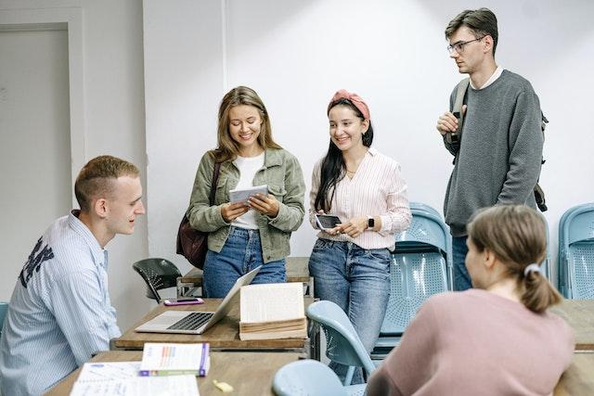
Youth eligibility requirements for the Burton Critical Needs and Opportunity Fund
Must be between the ages of 16 and 26 AND
Must have been in foster care OR experienced homelessness at any time.
Live in California
Participants are not required to be students.
Notes:
Amy

Slide 11
What can the Critical Needs and Opportunity Fund be used for?
The purpose of the fund is to be low barrier funding to pay for expenses related to a youth’s critical need or opportunity. Examples include:
Textbooks, school supplies or school fees
Transportation expenses or emergency auto repairs
Deposits for first and last month’s rent for a room or apartment
Obtaining medical or dental care when no Medi-Cal providers are available
Music or art classes
Participation in athletic programs
Notes:
Amy

Slide 12
Is There a Per Youth Spending Limit or Other Limitations?
There is no minimum or maximum. Given that the goal is to meet a youth’s specific need, we discourage using the funding to purchase a cache of gift cards.
Participating organizations are expected to use their funding based on their:
Knowledge of the youth’s specific circumstance
Professional judgment
Notes:
Amy

Slide 13
2024-2025 Process
Notes:
Amy

Slide 14
Who is eligible to apply for FY 24-25 funding?
Disburse ALL the funding received and have submitted the information via the Youth Disbursement Form by May 3, 2024.
Promote the Foster Youth Tax Credit in 1 of 3 ways:
Post on social media Foster Youth Tax Credit;
email flyer and self-filing guide to program participants;
refer program participants to a Volunteer Information Tax Assistance (VITA) site.
Notes:
Amy

Slide 15
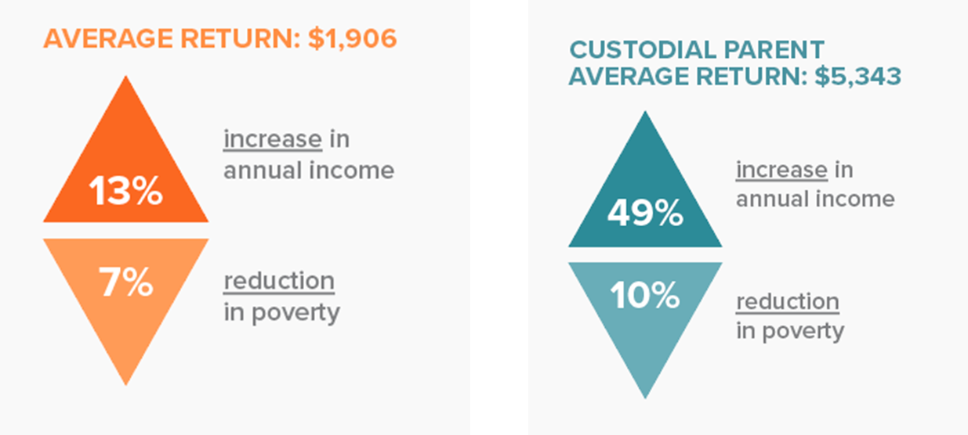
Foster Youth Tax Credit
In 2022, JBAY cosponsored a proposal that established the California Foster Youth Tax Credit. This tax credit allows current and former foster youth to claim up to $1,117 when they file their taxes.
Notes:
Amy

Slide 16
Program Timeline Overview
Application Open Between
April 22 - May 3, 2024
Signed MOU Agreements By
June 7, 2024
1st Grant Check Sent
Week of July 22, 2024
Each eligible organization interested in participating must submit a complete application with their W9.
Each eligible organization must have their authorized signatory sign the MOU agreement.
1st grant check will be sent to eligible organizations from the week of July 22, 2024.
Spending Deadline #1 December 6, 2024
Grant Check 2 Sent
Week of January 20, 2025
Spending Deadline #2
May 3, 2025
Organizations that do not spend their full amount and submit Youth Disbursement Forms will not receive Round 2 funding.
2nd grant check will be sent to eligible organizations from the week of January 20, 2025.
Organizations that do not spend their full amount and submit Youth Disbursement Forms will not be eligible in 2025-26.
Notes:
Lorris

Slide 17
Application Form
Be a nonprofit, which includes a postsecondary institution. The applicant cannot be an individual.
If a campus can’t accept the funding directly, identify a nonprofit to serve as the applicant.
We will send out an application form to the organizations who have attended our webinar.
Deadline to apply - May 3, 2024
JBAY will assess applicants and review if they met last year’s terms & conditions.
Notes:
Lorris

Slide 18
Information to Collect for the Application
Names, emails, and phone numbers for two staff contacts.
(We will require one contact person to be publicly listed on our roster
which is available on our website.)
The name and tax ID number for the applicant organization that will be entering into agreement with JBAY and will be accepting and managing the program funds.
Applicant organization’s W9 will need to be submitted with the application form
Notes:
Lorris

Slide 19
Funding Amount & Deadlines
JBAY will allocate funds based on:
Number of organizational applicants, and
Type of organizational applicants
Programs can expect to receive $4,000 to $9,000.
2 rounds of funding disbursement and deadlines
Disbursement | Deadline
Week of July 22, 2024 | December 6, 2024
Week of January 20, 2025 | May 3, 2025
Notes:
Lorris

Slide 20
Funding Agreement
Applicant must agree to:
Disburse funds to youth using their knowledge of the youth’s specific circumstance and their professional judgment.
Complete the electronic Youth Disbursement Form every time a student is awarded funds, within 48 hours of fund disbursement.
Use funds exclusively for expenses directly related to meeting the critical needs of a youth or to facilitate an opportunity for a youth.
Maintain records of expenditures for at least one year after completion of the use of the grant funds.
Notes:
Lorris

Slide 21
Funding Agreement
To be eligible to receive Round 2 of funding and be invited to participate in future funding:
Spend the funding allocated per round by the DEADLINE and submit the Youth Disbursement Form within 48 hours
The total amount submitted on the Youth Disbursement forms must cumulatively total to the grant amount provided to your organization.
The information from the Youth Disbursement Form advises JBAY whether organizations have been disbursing the funds and if we should send the next round of funding.
Notes:
Lorrs

Slide 22
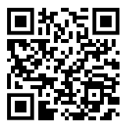
23-24 Feedback Survey
Your feedback is important to us and helps us improve our programs and services.
All responses will be confidential and anonymous.
Please scan the QR code or click on the link in our chat to fill in the feedback survey.
Notes:
Lorris/Amy

Slide 23
Youth Interviews
JBAY is interested in learning about the impact of the fund.
Youth can receive a $25 gift card for a 30-minute interview.
Provide youth’s information at the end of the Youth Disbursement Form if the youth is interested.
Please note that not all youths who are interested will be contacted for an interview.
Notes:
Lorris

Slide 24
Program Timeline Overview
Application Open Between
April 22 - May 3, 2024
Signed MOU Agreements By
June 7, 2024
1st Grant Check Sent
Week of July 22, 2024
Each eligible organization interested in participating must submit a complete application with their W9.
Each eligible organization must have their authorized signatory sign the MOU agreement.
1st grant check will be sent to eligible organizations from the week of July 22, 2024.
Spending Deadline #1 December 6, 2024
Grant Check 2 Sent
Week of January 20, 2025
Spending Deadline #2
May 3, 2025
Organizations that do not spend their full amount and submit Youth Disbursement Forms will not receive Round 2 funding.
2nd grant check will be sent to eligible organizations from the week of January 20, 2025.
Organizations that do not spend their full amount and submit Youth Disbursement Forms will not be eligible in 2025-26.
Notes:
Lorris

Slide 25
Next Steps
Make sure your organization disbursed ALL the funding received in FY 23-24 from the Critical Needs and Opportunity fund AND submit the Youth Disbursement form by May 3 2024 8pm.
Promote the Foster Youth Tax Credit via social media, email and/or text.
Complete the applicant form with supporting documentation by May 3rd
Notes:
Lorris

Slide 26
Enter your questions on your screen now
Click the “question and answer” arrow
Type your question
Click “send”
Questions?
Lorris can be
reached at:
Lorris@jbay.org
Notes:
Lorris

Slide 27
THANK YOU
JBAY.ORG
Notes:
Lorris

