Slide 1
“Claim Your Cash” Pilot
LA County Tax Credit Take-Up Program
March 2024

Slide 2
The average tax refund for a low- income taxpayers is about $2,500.
For Californians, there are additional benefits to support low-wage workers.
Let's get into it!

Slide 3
Currently Tax credits such as the Earned Income Tax Credit (EITC), Child Tax Credit (CTC) are the only way to provide direct, unrestricted cash at scale, to everyone who’s eligible.
Including California’s CalETC, YCTC, and Foster Youth Tax Credit
Notes:
However, in California we have more reach as we provide our EITC and CTC to ITIN holders…CTC is per child/ YCTC is per household up to the age of 6

Slide 4
Quick Reminder
We don’t expect you to be a tax expert…
…but you are our secret weapon!
We can’t do this without YOU!
Notes:
People will trust you, because you are a government agency….when people here free, they worry, but if they hear it from you they will know it’s a safe service.

Slide 5
Federal EITC Basics
The Federal EITC provides up to $7,430, depending
on income and family size.
The EITC is available to taxpayers with earned
income from a job or self-employment.
Taxpayers & any qualifying children need
valid Social Security numbers.
Taxpayers with no children must be
between the ages 25 to 65.
Taxpayers cannot be claimed as a dependent.
Notes:
By design and practice, many who have the hardest time getting tax credits are those who need them the most. This includes thousands of people who are already connected to government agencies through other benefits. Nearly half a million SNAP recipients who are eligible for CalEITC don’t receive it.

Slide 6
Federal CTC Basics
This year, the Federal CTC provides up to $2,000 per child.
Must have a qualifying child under the
age of 17 at the end of tax year.
Qualifying child must have a Social Security
number and issued before the due date
of the tax return (including extensions).
Parents who are ITIN holders can also claim the
CTC, if you have a qualifying child with a valid SSN.
Notes:
Beginning with tax year 2018 and through tax year 2025, you may be able to claim ODC, a nonrefundable credit for each eligible dependent who can't be claimed for the child tax credit. Up to $500
By design and practice, many who have the hardest time getting tax credits are those who need them the most. This includes thousands of people who are already connected to government agencies through other benefits. Nearly half a million SNAP recipients who are eligible for CalEITC don’t receive it.

Slide 7
About California State Tax Credits
California Earned Income Tax Credit (CalEITC)
Young Child Tax Credit (YCTC)
Foster Youth Tax Credit (FYTC)
WORKING PEOPLE THRIVE:
Credits for families with children each year lifts more than 10 million people out of poverty, including about 5 million children
Notes:
Our state taxes are more inclusive and available to more families
By design and practice, many who have the hardest time getting tax credits are those who need them the most. This includes thousands of people who are already connected to government agencies through other benefits. Nearly half a million SNAP recipients who are eligible for CalEITC don’t receive it.

Slide 8
CalEITC Basics
A taxpayer may qualify for up to $3,529 this year. The amount of the CalEITC credit you receive depends on your income and family size. CalEITC may provide you with cash back or reduce any tax you owe.
Taxpayers must have earned income of at least $1.00 and not more that $30,950 from a job or self- employment.
Taxpayers can claim this money even if they have a Individual Tax ID Number (ITIN).
Taxpayers may claim the credit as long as they are 18 or older and are not claimed as a dependent.

Slide 9
YCTC (Young Child Tax Credit) Basics
This year, the YCTC provides up to $1,117 per eligible household (not per child). YCTC may provide you with cash back or reduce any tax you owe.
Taxpayers must have a child under the age of 6 at the end of the tax year.
Taxpayers with $0 income can claim the Young Child Tax Credit.
Taxpayers can claim this money even if they have a Individual Tax ID Number (ITIN).

Slide 10
FYTC (Foster Youth Tax Credit) Basics
This year, the Foster Youth Tax Credit (FYTC) provides up to $1,117 per eligible individuals who:
Qualify for the California Earned Income Tax Credit (CalEITC);
Were age 18 to 25 at the end of the tax year; and
Were in foster care at age 13 or older and placed through the California foster care system.

Slide 11
New Tax Credit Just for Current & Former Foster Youth!
The California Foster Youth Tax Credit (FYTC)
First of its type in the nation! Became available in 2023. The FYTC is a cash back tax credit.
In 2024, the FYTC will provide up to $1,117 to youth who:
File their 2023 state tax return
Are age 18-25 at end of the tax year (12/31/23)
Were in foster care on or after 13th birthday
Earned between $1 - $30,931 in 2023
Lived in CA at least half of 2023
Download the flyer: https://jbay.org/resources/fytc-flyer/

Slide 12
In 2023:
4,889 youth received the FYTC
Each youth received an average of $1,039
$5,080,258 in total refunds!

Slide 13
More Money in People’s Pockets
This year, the Federal EITC is worth up to $7,430.
The CalEITC is worth up to an additional
$3,529.
(and households with young children or foster youth could get $1,117 more!)
The only way to get it is to file a tax return.

Slide 14
But, filing taxes is rife with barriers, especially for low-income families, immigrants, and people with language barriers.
So these families – who are disproportionately Black, Latinx, Native American, and immigrants – often don’t file tax returns, effectively locking them out of hundreds or even thousands of dollars in cash.
Notes:
Yet only 4 out of 5 people get the tax credits they need and qualify for
The hard to reach are hard to reach
On top of that, even when people know about the opportunities, there is understandable resistance and lack of trust

Slide 15
LA households miss out on over $500 million in EITC and other tax credits a year.
In Los Angeles, 1 in 5 individuals that are eligible for the EITC do not file a tax return.
Unfortunately, even many people who are connected to the county for other benefits or services are not claiming the cash that they qualify for.
Last year, only 3,164 households with $0 earnings applied for the Young Child Tax Credit (YCTC).
The state had estimated 55,000 households were eligible (based on CalWorks data)
Notes:
81k ITIN caleitc eligible filers in LA county

Slide 16
Consider someone who “Made Too Little To File”
Single parents who earned $18,000 last year:
One Child: $3,995 from EITC
Two Children: $6,604 from EITC and $1,400 from Additional Child Tax Credit
Three Children: $7,430 from EITC and $1,800 from Additional Tax Credit
And that’s only federal credits – CA credits provide even more!
Notes:
The hard to reach are hard to reach
On top of that, even when people know about the opportunities, there is understandable resistance and lack of trust

Slide 17
Targeting “Non-Filers”?
Many taxpayers do not file, but that means they could be missing out on thousands of dollars:
Individuals utilizing public benefits (misinformation about this!)
Part-time workers or seasonal workers
Earn cash or “money under the table”
Missed the “deadline” and may not know they can file late (if not required to file, there is no deadline)
Unhoused, gig workers, young adults
Undocumented workers
Made “too little to file”
Notes:
The hard to reach are hard to reach
On top of that, even when people know about the opportunities, there is understandable resistance and lack of trust

Slide 18
Misconceptions from “Non-Filers”
Your clients may make too little to have to file.
These individuals are usually owed large refunds!
Tax refunds are not considered income and do not impact your qualifications for public benefits.
Benefits like SSI, CalFresh, CalWorks, General Relief, etc. are not income.
You do not need to report these on your tax return.
Missed a tax year?
You can claim any refund up to 3 years after the filing deadline.
Immigrants can file their taxes and claim credits.
Tax refunds do not count as Public Charge for immigration.
Filing taxes can actually help your immigration process.
Notes:
Some people might file because of the following reasons

Slide 19
More Misconceptions: Tax Deadlines
To file federal tax returns, pay any tax owed or request an extension, the deadline to file is Monday, April 15.
Haven’t filed in a while? Tax refunds can be claimed up to 3 years after the filing deadline.
Taxpayers can still claim refunds, like pandemic stimulus and expanded CTC, from tax years 2020 - 2022.
The 2020 deadline is coming up soon on May 17, 2024.

Slide 20
Now let's get this money where it belongs –
in people’s pockets!
Notes:
We will now cover Tax situations, script, VITA information
The hard to reach are hard to reach
On top of that, even when people know about the opportunities, there is understandable resistance and lack of trust

Slide 21
CERTIFIED VOLUNTEERS ARE AVAILABLE TO HELP WITH FREE TAX PREP SERVICE.
Notes:
Now that we understand why this program is important, we need to go over VITA, how to connect with VITA, and what happens when you do connect.

Slide 22
Volunteer Income Tax Assistance (VITA)
VITA programs offer FREE basic tax return preparation to qualified individuals.
How to connect:
Connect with a call center representative 1-888-844-3276
Number is reserved for county agencies so you can get live assistance right away!
Volunteer Income Tax Assistant (VITA) sites listed at
www.ClaimYourCashLA.com
Select a location and schedule a tax appointment immediately.
Clients receive a confirmation text and email with all the details for the appointment.
Notes:
Highlight the fact that most people hear “free” and are not sure, but since they are a seen as a trusted partner they are more likely to schedule appointments

Slide 23
VITA Facts
VITA volunteers have to be certified each year
Which means they stay up to date with latest changes & benefits
VITA centers are trusted community partners
Most locations provide other services, including ITIN assistance
Paid tax preparers charge between $220 to $300 to file taxes
For many, this cost eats up 10% of the value of their credits!
ITIN Holders are the population to most likely pay to file taxes, even though they qualify for free tax preparation.
203,627 completed by a paid tax preparer out of a total of 231,441 CalEITC ITIN Claims statewide.
LA County had 1,006,224 combined 2023 CalEITC, YCTC, FYTC claims filed
Statewide we had a total of 3,458,195 combined claims, yet almost 58% of those claims were filed via paid preparer, about 39.7% self-prepared, and only 2.3% were filed via VITA.
Notes:
Paid tax preparers don’t have to, all they have to do is hold a bond.
Many will also charge to review and resubmit for an additional credit they might have missed as happened with the FYTC
LA County has the most filers,
Over 81k ITIN eitc claims in LA County

Slide 24
To make sure everyone is getting the tax credits they qualify for, we’ve designed a simple and helpful system to directly connect people to free tax prep help.
We call it the “warm handoff”
Schedule an appointment
- Website
- Call Center
More money in the pockets for our clients.
Warm Hand-off, Education, and Marketing
Access free tax preparation
County Agency
Claim Your Cash Resources
VITA Sites
County clients win!
Notes:
First step: get people who are already connected to us through other benefits. Lowest-hanging fruit
By design and practice, many who have the hardest time getting tax credits are those who need them the most. This includes thousands of people who are already connected to government agencies through other benefits. Nearly half a million SNAP recipients who are eligible for CalEITC don’t receive it.

Slide 25
Main Pilot Goals
Connect a minimum of 3,000 low-income households with state and federal tax credits they are currently not receiving (non-filers)
Deliver at least $9 million in new state and federal tax credits for these households, creating approximately $17 million in economic activity.
Expand the capacity of the current VITA sites within the network to process more clients (year-round)
Establish new sites, including at existing government locations, and add them to the network focusing on “VITA deserts,” such as Antelope Valley and Southeast LA
Notes:
Main goal is to target non-filers
The hard to reach are hard to reach
On top of that, even when people know about the opportunities, there is understandable resistance and lack of trust

Slide 26
How it works
The "warm handoff" is critical to helping people go from awareness and action:
During regular interactions with County programs, staff asks the program participant about tax filing, and asks if the person has claimed these credits.
If not, staff helps the person – right then and there – set up an appointment with free tax prep at a VITA location by calling a staffed call center number or using the simple online booking system.
The VITA free tax prep services are run by community partners – and these trained partners will take it from there to make sure the person files their taxes and claims these valuable credits.
This is a “high-touch” intervention that leverages trust to get people all the resources they qualify for.
BUT ALSO…
These agencies, as well as others that are not providing the warm handoff, will send targeted and repeated communications – texts, calls, and in-person interactions – to households in their database to make sure everyone knows about the free tax prep services available at local VITA sites, and how to sign up.
This is a “low-touch” intervention intended to not only generate awareness, but so that people are hearing the same info from multiple sources, which increases trust in free tax prep services, making them more likely to file.
AND THEN…
The community partner will assist people in filing their taxes for free – so that every LA County household gets their cash back!
Notes:
By design and practice, many who have the hardest time getting tax credits are those who need them the most. This includes thousands of people who are already connected to government agencies through other benefits. Nearly half a million SNAP recipients who are eligible for CalEITC don’t receive it.

Slide 27
Now let’s practice…If yes…
Staff: We want to make sure you're getting EVERY benefit you and your family qualify for. Have you filed your taxes?
The government owes a lot of people money, and you might be owed hundreds or thousands of dollars in tax credits. This money won't affect any other programs such as CalFresh, Calworks that you're using, and you can use it for anything you need.
If yes:
Great! Do you know if you got the Earned Income Tax Credit or Young Child Tax Credit?
If no or I don’t know: That’s OK. We can help you get it figured out. If you didn’t get these credits, you may be eligible for cash back depending on how much money your family makes and how many kids you have.
If yes: That’s great. If you didn’t file your taxes in any of the past three years, you may be eligible for cash back from those years, too. Are you interested in talking to a free tax clinic to see if you might have qualified in the last three years? [If yes, proceed to Connect; if no, continue to free tax prep]
Free tax prep: OK, the last thing I want to tell you is that if you paid to file your taxes – either online or a person or business – know that you are able to get free tax help. Whether you’re filing your taxes or just have a question about your taxes, you can reach out to these free neighborhood clinics to get help. Let me give you the information. <phone number and https://www.freetaxprepla.org/locations.>
Notes:
Will share script docs during this portion…

Slide 28
Now let’s practice…If no…
If no:
Depending on how much money your family makes and how many kids you have, you could get up to ten thousand dollars ($10,000). We can look at this chart together, which will show you how much you may get. [Show chart and proceed to Connect]
Connect:
We’ll connect you with a tax expert who will help you file and claim these credits for FREE.
Sounds good? Let’s get you scheduled for an appointment. We can set it up online or over a call, whichever you prefer.
There are a few documents you'll need, but we'll go over that, so that you're ready for the meeting.
If hesitant or say “not now”:
Free tax prep: OK, just know that you are able to get free tax help. Whether you’re filing your taxes or just have a question about your taxes, you can reach out to these free neighborhood clinics to get help. Let me give you the information. <phone number and https://www.freetaxprepla.org/locations.>
Notes:
If it’s a Foster Youth, mention that as well.

Slide 29
Possible Tax BreakDown
Tax Year 2023 maximum income and credit amounts for CalEITC and related tax credits.
Number of qualifying children | CalEITC Max Income | CalEITC Max Credit (Up To) | YCTC/FYTC Max Income (up to) | YCTC Max Credit | FYCT Max Credit | EITC Federal Max Credit
 | (up to) | (up to) | (up to) | (up to) | (up to) | (up to)
None | $30,950 | $285 | $30,931 | $0 | $1,117 | $600
1 | $30,950 | $1,900 | $30,931 | $1,117 | $1,117 | $3,995
2 | $30,950 | $3,137 | $30,931 | $1,117 | $1,117 | $6,604
3 or more | $30,950 | $3,529 | $30,931 | $1,117 | $1,117 | $7,430
Notes:
FTB website

Slide 30
Schedule a tax appointment online: www.claimyourcashla.com
Notes:
If it’s a Foster Youth, mention that as well.

Slide 31
Schedule a tax appointment online: www.claimyourcashla.com
Notes:
If it’s a Foster Youth, mention that as well.

Slide 32
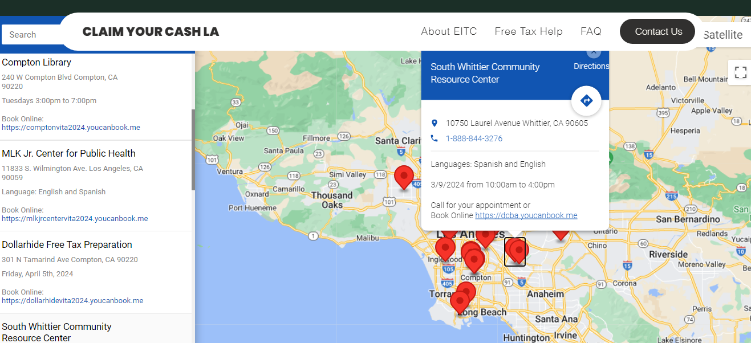
Schedule a tax appointment online: www.claimyourcashla.com
Notes:
If it’s a Foster Youth, mention that as well.

Slide 33
The Tax Prep Checklist Will Tell You How to Prepare for Filing Your Taxes.
You can download it here: https://jbay.org/resources/tax-prep/

Slide 34
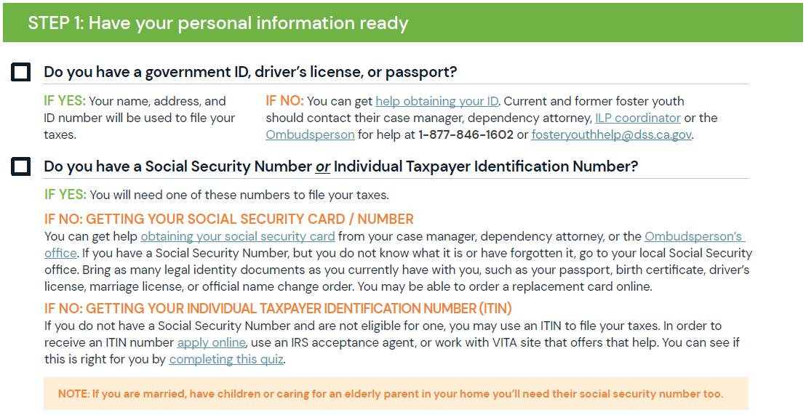

Slide 35
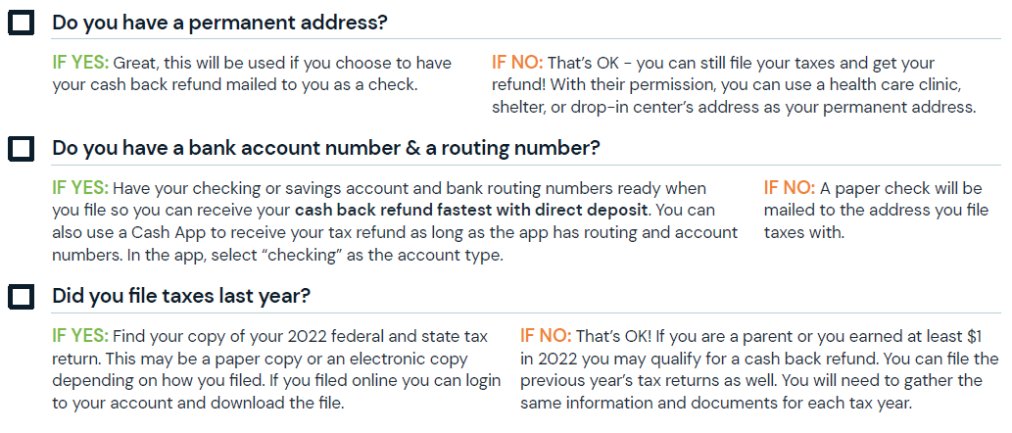

Slide 36
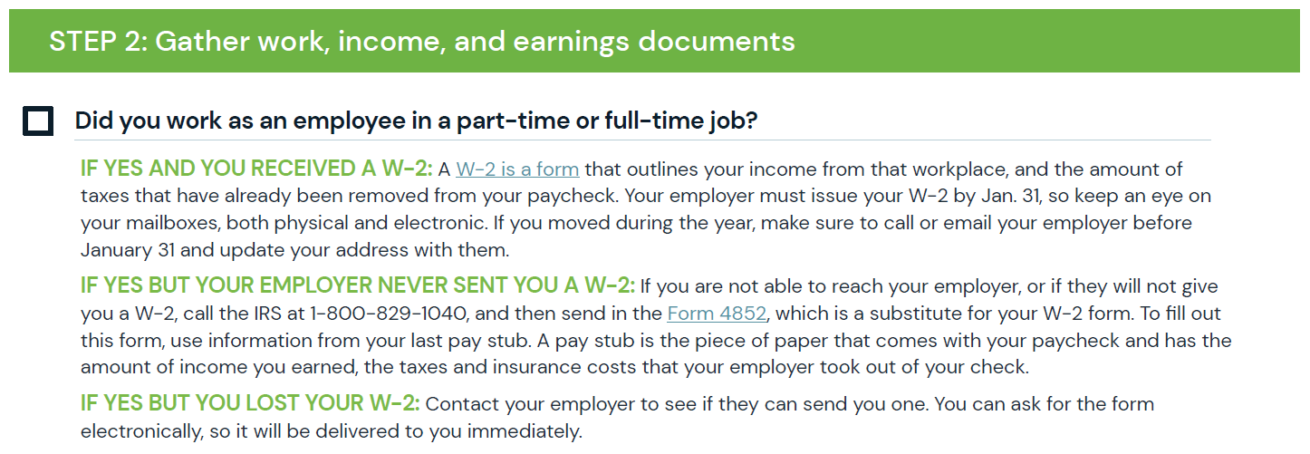

Slide 37
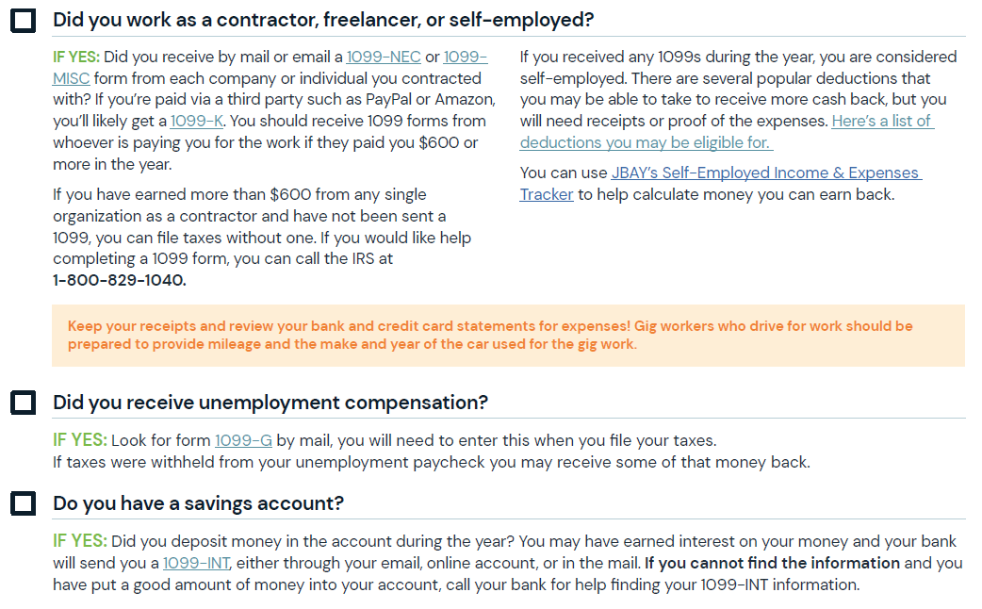

Slide 38
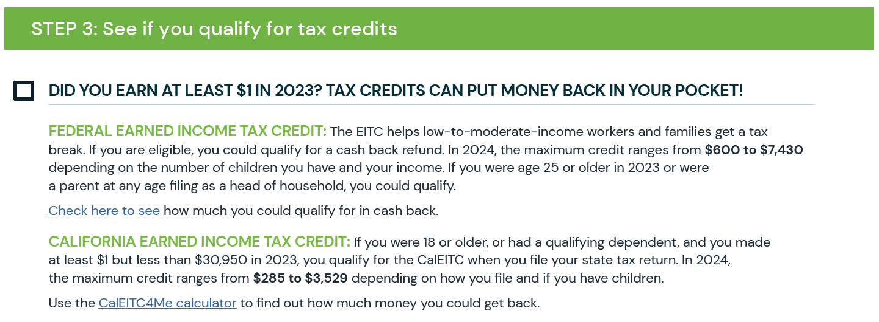

Slide 39
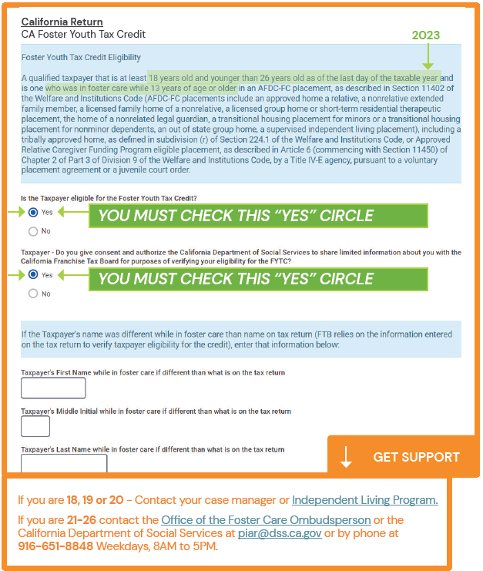
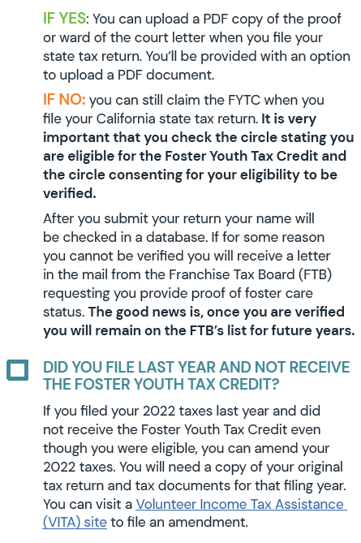

Slide 41
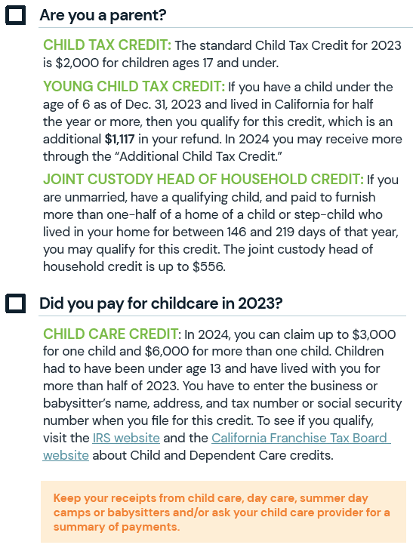

Slide 43
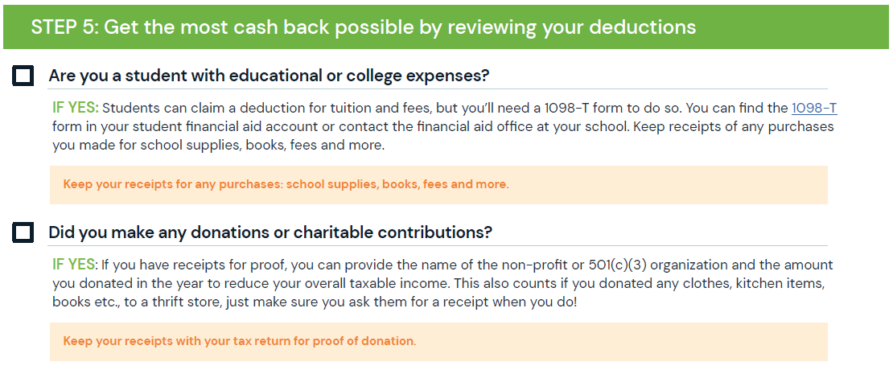

Slide 44
Thank you and Questions….
Need additional support?
Feel free to contact:
Kristina Meza, Executive Directors, Poverty Alleviation, CEO’s Office, (213) 474-0640, kmeza@CEO.lacounty.gov
Audrey Casillas, Assistant Director,Community Economic Development Services, KYCC, (213) 365-7400 Ext. 5235, acasillas@kyccla.org
Mónica V. Lazo, Southern California Program Director, ESCA,
(562) 822-9209, monica@economicsecurity.us

