Slide 1
Sexual and Reproductive Wellness for Youth in Foster Care
Resource Family Pre-Approval Training

Slide 2
Goals of the Training
Inform caregivers of:
The sexual and reproductive health rights of youth in foster care
Their duties and responsibilities as a caregiver as well as those of the caseworker
How to engage with youth about sexual and reproductive wellness
Current contraceptive methods and resources to share with youth
2
Notes:
Important to note that when we reference foster youth, we are discussing both minors and non-minor dependents

Slide 3
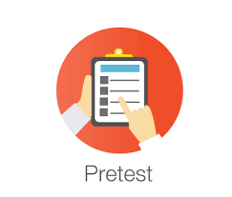
Pre-Test
Take a moment to fill out the brief pre-test.
3

Slide 4
Why is Sexual & Reproductive Wellness in Foster Care Important?
4

Slide 5
Why is Sexual & Reproductive Wellness in Foster Care Important?
Of the foster youth who experienced pregnancy, most reported it was not intentional:
66.3% of young men
70.7% of young women
5
5
Midwest Study, Courtney, et. al., 2007
CalYOUTH, Courtney et. al., 2016

Slide 6
STIs in Foster Care
6
6
Notes:
Teensource.org/std
CDC Sexually Transmitted Disease Surveillance 2016. Atlanta. US Dept. of Health and Human Services; 2017.
CDC. Youth Risk Behavior Surveillance—United States, 2017. MMWR Surveill Summ 2018;67(No. SS-8).
CDC. Diagnoses of HIV Infection in the United States and Dependent Areas, 2016. HIV Surveillance Report 2016, vol. 28; November 2017.
CDC. Sexually Transmitted Disease Surveillance 2016. Atlanta: U.S. Department of Health and Human Services; 2017.
Martin JA, Hamilton BE, Osterman MJK, Driscoll AK, Drake P. Births: Final data for 2016. National Vital Statistics Report Rep 2016; vol 67, no 1. Hyattsville, MD: National Center for Health Statistics. 2018.

Slide 7
Implications of Unintended Pregnancy and the Related Outcomes Among Foster Youth
Barriers to Higher Education
At age 19, of those who had not enrolled in higher education, 30% cited the need for child care as a major barrier to returning to school
Economic Instability
Economic costs to youth & child welfare system
At age 24, having a child reduced a woman’s odds of being employed by 30%—even after holding educational attainment constant
Child Maltreatment
Children born to foster youth were 3 times more likely to have a substantiated report of maltreatment by age 5 than children born to the same-age youth not in foster care
7
7
Notes:
(Cite for Education section)
Courtney et al., Findings from the California Youth Transitions to Adulthood Study: Conditions at age 19 (2016). http://www.chapinhall.org/sites/default/files/CY_YT_RE0516_1.pdf.
(Cite for financial section)
National Research Council (US) Panel on Adolescent Pregnancy and Childbearing; Hofferth SL, Hayes CD, editors. Risking the Future: Adolescent Sexuality, Pregnancy, and Childbearing, Volume II: Working Papers and Statistical Appendices. Washington (DC): National Academies Press (US); 1987. CHAPTER 6, SOCIAL AND ECONOMIC CONSEQUENCES OF TEENAGE CHILDBEARING. Available from: https://www.ncbi.nlm.nih.gov/books/NBK219229/.
(Cite for reports of maltreatment statistic)
Corcoran, Jacqueline. Consequences of Adolescent Pregnancy/Parenting: A Review of the Literature, Social Work Health Care Press (1998).

Slide 8
California Foster Youth Sexual Health Education Act (Senate Bill 89)
Quality Sexual Health Training for foster caregivers, case mangers, and judges.
Informing Youth of their SRH Rights and Removal of Barriers
Improved Access to Sexual Health Education
Quality Sexual Health Training for foster caregivers, case mangers, and judges
This very training is part of the SB 89 implementation and is to inform caregivers about the sexual and reproductive rights of foster youth, duties and responsibilities, contraceptive methods and resources for information and care.
Senate Bill 89 (Leyva) aims to build systems to eliminate sexual & reproductive health (SRH) disparities among foster youth. It went into effect as of July 2017.
8
8

Slide 9
Sexual and Reproductive Wellness Rights of Youth in Foster Care
9

Slide 10
Sexual Health as a Human Right
“Sexual health is a state of physical, emotional, mental and social well-being in relation to sexuality; it is not merely the absence of disease, dysfunction or infirmity…”
--World Health Organization
10
10

Slide 11
Right #1: Right to Consent to Medical Care For:
AT ANY AGE:
Contraception, including Long Acting Reversible Contraception (LARC) and Emergency Contraception
Pregnancy Testing
Prenatal and Postnatal Care
Abortion
Diagnosis and treatment of sexual assault
12 Years or Older:
Prevention, diagnosis, and treatment of STIs and HIV
Foster youth can receive this care without need for consent from a parent, caregiver, guardian, social worker, probation officer or the court.
A provider cannot require consent from anyone else but the youth.
A provider cannot provide the care without a youth’s consent.
11
11
CDSS All-County Letter 16-82
Notes:
For more info about minor consent laws: www.TeenHealthLaw.org

Slide 12
Scenario
Emily, 15, and her caregiver go to the health provider. Her caregiver, who cares deeply for Emily, tells the provider: ”Look, I’ve had too many teens get pregnant under my care. Please give Emily an Intrauterine Device (IUD) to make sure it doesn’t happen to her.”
Who consents for an IUD?
Who is not permitted to consent for Emily?
12
12
Notes:
Emily has the right to consent or deny getting an IUD.

Slide 13
Right #2: Right to Privacy in Exams
What does this mean?
A caregiver or case worker cannot be in the room when the youth is receiving care, unless the youth requests so.
Medical provider cannot begin sharing information or asking questions to youth while the caregiver or case worker are present unless the youth requests so.
The right to privacy for examination or treatment by a medical provider--unless the youth specifically requests otherwise.
13
13
CDSS All-County Letter 16-82
Notes:
Reference: See the “Youth Brochure” handout and “All County Letter 16-82”

Slide 14
Right #3: Right to Privacy in Health Information
What does the right to confidentiality mean?
If a youth receives reproductive and sexual health services and/or asks questions about sex, contraception or other related topics during a health appointment, the provider cannot share with the youth’s parents, caregivers, group home, social worker, probation officer or others without the youth’s written consent.
The right to patient confidentiality regarding sexual and reproductive health services and records.
Some examples of services are:
a youth seeing a doctor for birth control
getting a cervical exam/pap smear
having an IUD inserted
seeing a doctor for a pregnancy test
14
14
CDSS All-County Letter 16-82
Notes:
Reference: See the “Youth Brochure” handout and “All County Letter 16-82”

Slide 15
Right #4: Right to Obtain and Use Contraception
Scenario
Jason is a 17-year-old who is sexually active. At an educational program he attends after school, they are handing out paper bags with some condoms and sexual health pamphlets. He politely declines and says his caregiver won’t let him have the condoms because they don’t believe in sex before marriage, so he might as well not take them.
What are Jason’s rights?
The right to obtain, possess and use the contraception of their choice, including condoms.
15
15
CDSS All-County Letter 16-82
Notes:
Reference: See the “Youth Brochure” handout and “All County Letter 16-82”
Contraception cannot be taken away as part of discipline or for religious beliefs, personal biases and judgements of another person.

Slide 16
Right #5: Right to Storage Space in Placement
Birth control, condoms, or other protection cannot be taken away from youth as a punishment or due to caregiver’s religious beliefs or personal feelings.
The right to have private storage space and to be free from unreasonable searches of his or her personal belongings.
16
16
CDSS All-County Letter 16-82
Notes:
Reference: See the “Youth Brochure” handout and “All County Letter 16-82”

Slide 17
Right #6: Right to Provider of Choice in Timely Manner
Scenario
Raquel thinks she needs emergency contraception and asks her caregiver to drive her to the drug store. Her caregiver says that she’ll make an appointment for Raquel with their local pediatrician instead.
What are Raquel’s rights?
The right to receive medical services, including reproductive and sexual health care, and to choose their own health care provider if service is covered under Medi-Cal or their health insurance.
17
17
CDSS All-County Letter 16-82
Notes:
Reference: See the “Youth Brochure” handout and “All County Letter 16-82”

Slide 18
Right #7: Right to Transportation
Many reproductive health services are time-sensitive (e.g. emergency contraception, abortion); therefore, transportation must be provided in a timely manner in order to meet the requirement.
The right to be provided transportation to reproductive and sexual health related services.
18
18
CDSS All-County Letter 16-82
Notes:
Reference: See the “Youth Brochure” handout and “All County Letter 16-82”
Religious affiliation of caregiver doesn’t matter.

Slide 19
Right #8: Right to Age Appropriate Medically Accurate Information
The right to have access to age-appropriate, medically accurate information about:
reproductive and sexual health care,
the prevention of unplanned pregnancy including abstinence and contraception,
abortion care,
pregnancy services, and
the prevention, diagnosis, and treatment of STIs, including but not limited to the availability of the Human Papillomavirus (HPV) vaccination.
19
19
CDSS All-County Letter 16-82
Notes:
Reference: See the “Youth Brochure” handout and “All County Letter 16-82”

Slide 20
Right #9: Right to Notify Agencies of Violations of Rights
California Office of the Foster Care Ombudsperson
1-877-846-1602
fosteryouthhelp@dss.ca.gov
California Department of Social Services, Community Care Licensing
1-844-538-9766
The right to independently contact state agencies regarding violations of rights to speak to representatives of these offices confidentially, and to be free from threats or punishment for making complaints.
20
20
CDSS All-County Letter 16-82
Notes:
Reference: See the “Youth Brochure” handout and “All County Letter 16-82”

Slide 21
LGBTQI and Gender Non-Conforming Youth
Same rights as other foster youth
Fair and equal access to all available services, placement, care, and treatment and benefits and freedom from harassment and discrimination
Access to gender-affirming medical and behavioral health care; required by Assembly Bill 2119
Access to comprehensive sexual and reproductive education, resources, and service providers
Adequately trained caregivers and child welfare personnel
LGBTQI = Lesbian, Gay, Bisexual, Transgender, Queer, Questioning, Intersex
Gender non-conforming means that the youth does not identify as male or female or switches fluidly between the two (non-binary).
21
21
CDSS All-County Letter 16-82
CDSS All County Information Notice 1-30-18
Notes:
Reference: See the “Youth Brochure” handout and “All County Letter 16-82”
ACIN 1-30-18 SB 731 Frequently Asked Questions

Slide 22
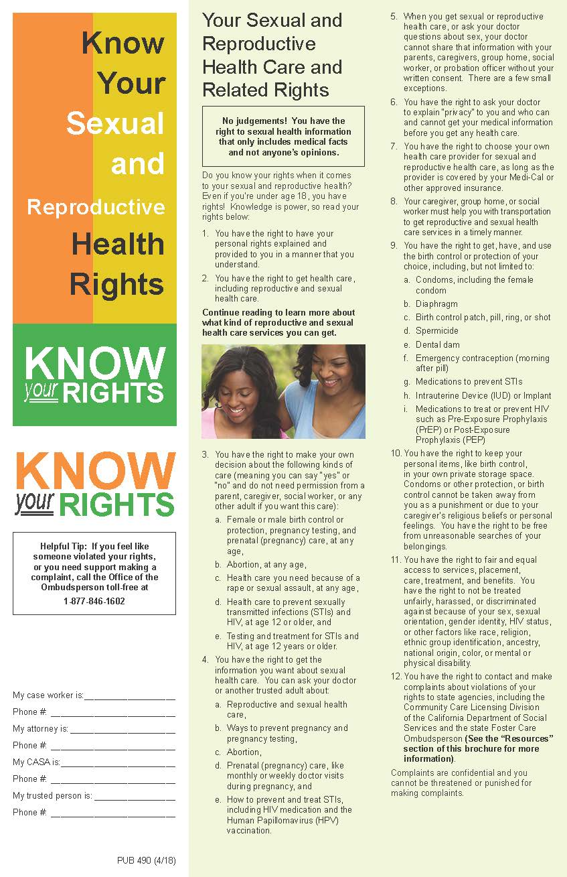
CDSS Know Your Sexual and Reproductive Health Rights Brochure
Available at http://www.cdss.ca.gov/inforesources/Foster-Care/Healthy-Sexual-Development-Project/Healthy-Sexual-Development-Resources
Also available in Spanish
Many youth will receive this brochure from their social worker as they are required to inform youth of their sexual health rights annually starting at age 10
22
22

Slide 23
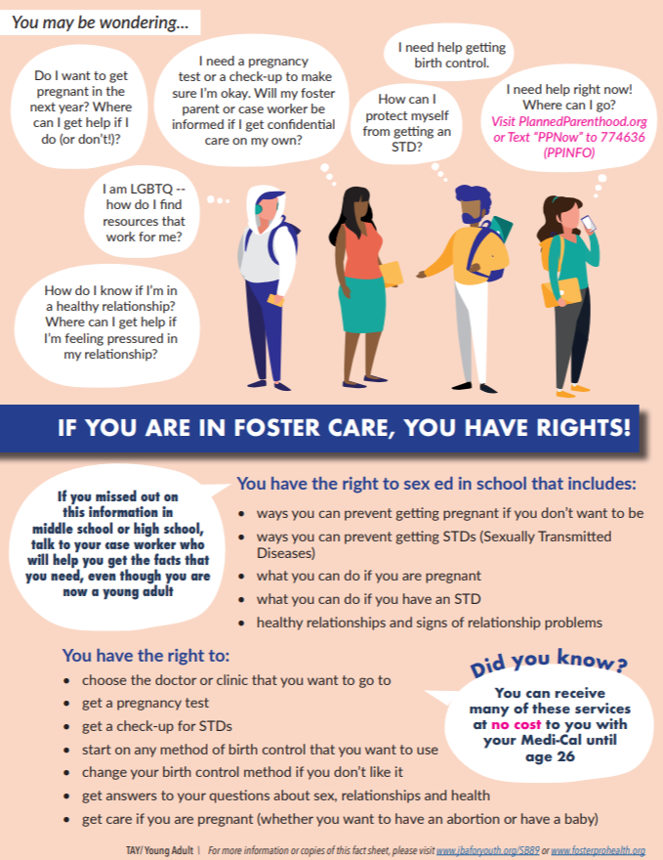
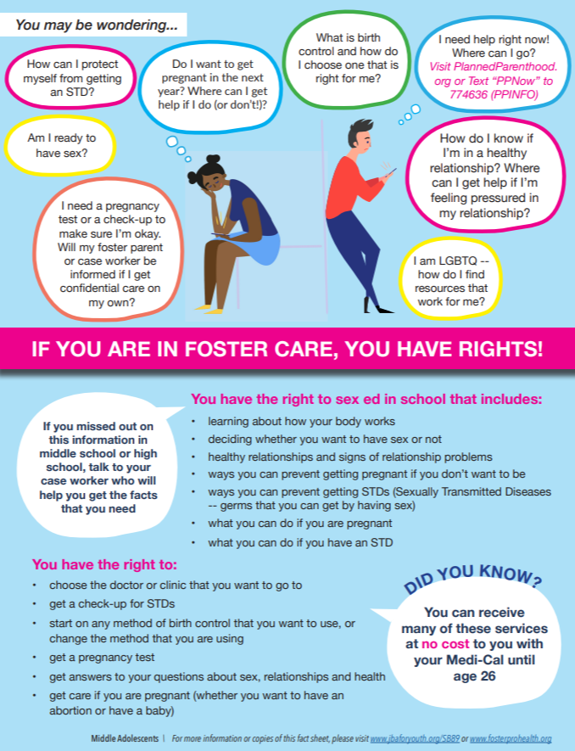
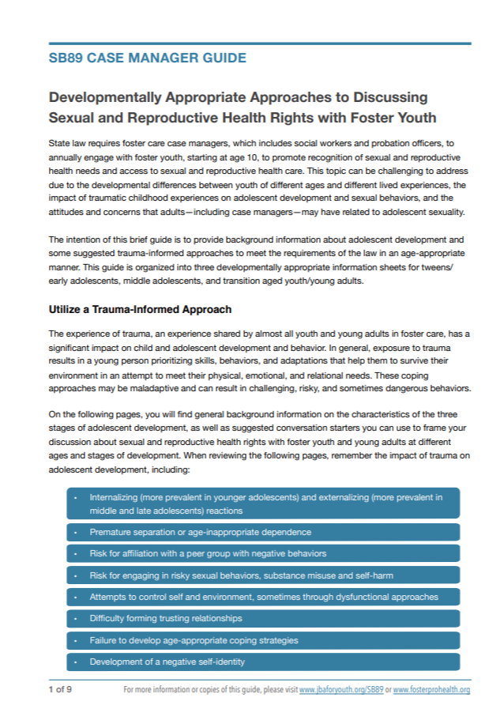
Youth Factsheets & Guide
Get familiar with Youth Factsheets and Accompany Guide: Developmentally Appropriate Approaches to Discussing Sexual and Reproductive Health Rights with Foster Youth
Age and Developmentally Appropriate Factsheets that Discusses Youth Rights
Overview of Youth Developmental Characteristics
Conversation Starters
Online resources
Available at: https://www.jbaforyouth.org/sb89-factsheets-and-guide/
23
23
CDSS All County Letter 16-31

Slide 24
Duties and Responsibilities of the Caregiver and Case Worker
24

Slide 25
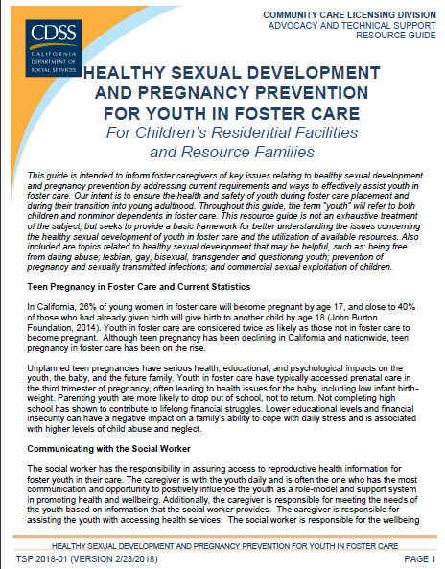
So, Whose Job is It to “Operationalize” These Rights?
CAREGIVER
&
CHILD WELFARE
WORKER
Get familiar with A Guide for Children’s Residential Facilities & Resource Families: Healthy Sexual Development and Pregnancy Prevention For Youth in Foster Care
Required and recommended duties
Tips for talking with youth
Case scenarios (and the answers to the questions)
Online resources
25
25
CDSS All-County Letter 16-82

Slide 26
Caregiver Duty #1: Use of Reasonable and Prudent Parent (RPP) standard
Recommended Questions when Applying RPP Standard
Does the activity seem reasonable?
Is this activity age or developmentally appropriate for the child?
Is this activity appropriate given the child’s maturity?
Is this activity consistent with the health, safety, and best interests of the child?
Does this activity encourage the emotional, developmental, or cultural growth of the child?
Does this actively assist in normalizing life in foster care?
What are the inherent risks, hazards, or harms related to the activity?
Is there anything based upon the child’s history to suggest that this activity would not be appropriate?
Reasonable and Prudent Parent (RPP) Standard
“Careful and sensible parental decisions that maintain the child’s health, safety, and best interests while at the same time encouraging the emotional and developmental growth of the child.”
Youth engage in age and developmentally appropriate social activities
Respect and protect youth’s right
26
26
CDSS All County Letter 16-31

Slide 27
Caregiver Duty #2: Assist the youth to access health services
Scenario
The youth lets the caregiver know they have become sexually active with a partner.
What to do?
Includes all of the sexual health services they can consent to as minors
Abortion
Birth control including Long Acting Reversible Contraception (LARC)
HIV and STD testing and treatment for youth age 12 and older
27
27
Responsibilities listed with legal and regulatory citations in CCL’s
“Healthy Sexual Development Resource Guide for Children’s Residential Facilities and Resource Families”
Notes:
Scenario answer:
The caregiver can review the Reproductive and Sexual Health Care Rights with the youth.
The caregiver can offer reliable, non-biased information on safe sex and birth control to the youth.
The caregiver can direct the youth to reliable websites with information about various types of birth control methods for pregnancy prevention.
The caregiver can assist the youth in making an appointment with a health provider who can explain different birth control options.
The caregiver shall provide transportation to the health care appointment.

Slide 28
Caregiver Duty #3: Respect of private storage and personal belongings
Guidance directs caregivers to refer to Reasonable and Prudent Parent standards for self administration of medicine for minors.
Youth may privately store condoms and spermicide purchased over the counter or acquired from a medical provider, as personal items.
For youth who are 18 or older, the resource family shall permit the youth to access medications necessary for self-administration.
28
28
Responsibilities listed with legal and regulatory citations in CCL’s
“Healthy Sexual Development Resource Guide for Children’s Residential Facilities and Resource Families”

Slide 29
Caregiver Duty #4: Communicate with caseworker if assistance is needed
When discussing with the caseworker, communicate:
Topics discussed about sexual and reproductive wellness
Resources and information provided about sexual and reproductive wellness to the youth
Offers to remove any barriers the youth may experience accessing reproductive health
This disclosure describes the action taken to assist the youth, rather than protected information about the youth.
Communicate with the caseworker if referrals must be made or they require assistance accessing resources and services
Important to maintain the confidentiality of the youth and only disclose information that the youth allows
29
29
Responsibilities listed with legal and regulatory citations in CCL’s
“Healthy Sexual Development Resource Guide for Children’s Residential Facilities and Resource Families”

Slide 30
Caregiver Duty #5: Maintain the Youth’s Privacy and Confidentiality
This applies to all minors; foster youth do not lose these rights because they enter foster care.
Because sexuality is a sensitive and highly personal subject, it is important that the caregiver maintain the youth’s confidentiality and not share information that the youth has not consented to. This includes but is not limited to:
Sexual Orientation
Use of Contraceptives
Past Services Utilized
Rights to Confidentiality with Health Providers:
Health care provider cannot share with the youth’s parents, caregivers, group home, social worker, or probation officer without the youth’s consent.
When getting a medical related service from their doctor, they may request their doctor, to maintain confidentiality and ask the youth for their consent prior to any potential release of information.
Youth has a right to withhold consent to disclosure
30
30
Responsibilities listed with legal and regulatory citations in CCL’s
“Healthy Sexual Development Resource Guide for Children’s Residential Facilities and Resource Families”

Slide 31
Caregiver Duty #6: Direct youth to reliable sources of information
Caregivers are not expected to be an expert or even be comfortable with discussing sexual health related issues but can still direct youth and help facilitate access to information they need. Sources should be:
Medically-accurate
Age-appropriate
Nonbiased and nonjudgmental
Age Appropriate Resources to Share with Youth:
https://www.jbaforyouth.org/youth-sexual-health-resources/
31
31
Responsibilities listed with legal and regulatory citations in CCL’s
“Healthy Sexual Development Resource Guide for Children’s Residential Facilities and Resource Families”

Slide 32
Caregiver Duty #7: Arrange for timely transportation to services
Examples:
Transportation to the health care appointment when youth discloses they are sexually active
Transportation to the health care appointment when youth discloses they are pregnant and would like an abortion
Transportation to therapy, rape counseling or support groups when youth discloses they have forcibly had sex
Caregivers are required to arrange for timely transportation to health-related services, as many reproductive health services are time-sensitive.
32
32
Responsibilities listed with legal and regulatory citations in CCL’s
“Healthy Sexual Development Resource Guide for Children’s Residential Facilities and Resource Families”

Slide 33
Caregiver Duty #8: Do not impose personal biases or beliefs
Do not impose your judgements or biases on youth
Be respectful and professional
Do not force, coerce, or judge youth
Do not refuse to address any issue based on your own feelings or beliefs
Be sensitive to trauma and cultural identity, which can greatly affect how youth view their own sexuality
33
33

Slide 34
Thought Exercise
Thought Exercise
To remain open and compassionate, we can ask ourselves:
How can I set my assumptions aside so I can get to know this person as this person is? It may help to make a commitment to set assumptions aside before meeting with/ having a discussion with the youth.
Perspective-taking
Involves taking another person’s viewpoint intentionally.
Try to imagine what it might feel like to be an LGBTQI youth who is meeting with you for the first time.
What thoughts might come to mind?
What might you worry about, or look forward to?
34
34

Slide 35
Caseworker Duty #1: Confirm Receipt of Sex Ed in School
For all youth 10 years of age or older who are in middle or high school, case worker must verify that they have received or will receive comprehensive sexual health education compliant with California Healthy Youth Act from their public school once in:
If the youth did not receive the instruction in school, the county must ensure they receive the education through an alternative source
Middle School
High School
35
35
CDSS All-County Letter 16-82

Slide 36
Caseworker Duty #2: Annual Conversation
For youth 10 years of age and older, caseworkers annually must inform youth of their:
Caseworkers must do so in an age-appropriate and medically accurate way.
Right to consent to sexual and reproductive health services and his or her confidentiality rights regarding those services.
How to access reproductive and sexual health care services
Right to access age-appropriate, medically accurate information about reproductive and sexual health care.
36
36
CDSS All-County Letter 16-82

Slide 37
Caseworker Duty #3: Facilitate Access & Remove Barriers
Examples
Youth is unaware of their insurance information or does not have a copy of his/her medical card
Youth does not know how to schedule a sexual health doctor’s appointment or is too embarrassed
Youth reports that resource family prohibits or confiscates contraception
Youth reports that placement does not let youth seek sexual health care at preferred provider
Regular care provider doesn’t feel trustworthy to youth
For youth 10 years of age and older, caseworkers must annually:
Facilitate access to care, including by assisting with any identified barriers to care, as needed.
37
37
CDSS All-County Letter 16-82

Slide 38
How to Engage with Foster Youth about Sexual & Reproductive Wellness & Information about Contraceptive Methods
38

Slide 39
Talking vs. Engagement
Talking to youth
Providing information
Responding thoughtfully
Listening
Engaging with youth
Building trust
Asking questions
Being reliable and consistent
Following up
Listening some more
39
39

Slide 40
Trauma-Informed Approaches
Individualize your approach to meet the needs of the young person you are caring for
Work to earn and maintain a trusting relationship
Acknowledge the difficulty of the topic and recognize trauma-symptoms that may interfere with the discussion
Discussing confidentiality and situations that might result in the need to breach confidentiality is an essential step in building trust
Ask Permission
Utilize a strength-based approach
Build on what the youth already knows, recognizing their effort to protect and manage their sexual wellness, and explore and support their desires and choices
The young person may not be ready to discuss their sexual and reproductive needs when you had planned and may need additional time to feel comfortable have a discussion
40
40

Slide 41
Prepare Yourself!
Resources:
Conversation Starters and Youth Factsheets:
Explore your own attitudes and biases related to adolescent sexuality
Review Resources & update your knowledge about Sexual and Reproductive Wellness
You don’t have to be a subject matter expert. It is okay to say “I don’t know – what do you think or let’s find out together.”
Be familiar with the law and understand their rights related to their sexual wellness
Strive to use everyday situations as teachable moments
www.jbaforyouth.org/sb89-factsheets-and-guide/
Age Appropriate Resources to Share with Youth:
https://www.jbaforyouth.org/youth-sexual-health-resources/
Tip & Tools for Trusted Adults:
Powertodecide.org/sexual-health/resources-for-champions-advocates/materials-for-parents-champions-mentors
41
41

Slide 42
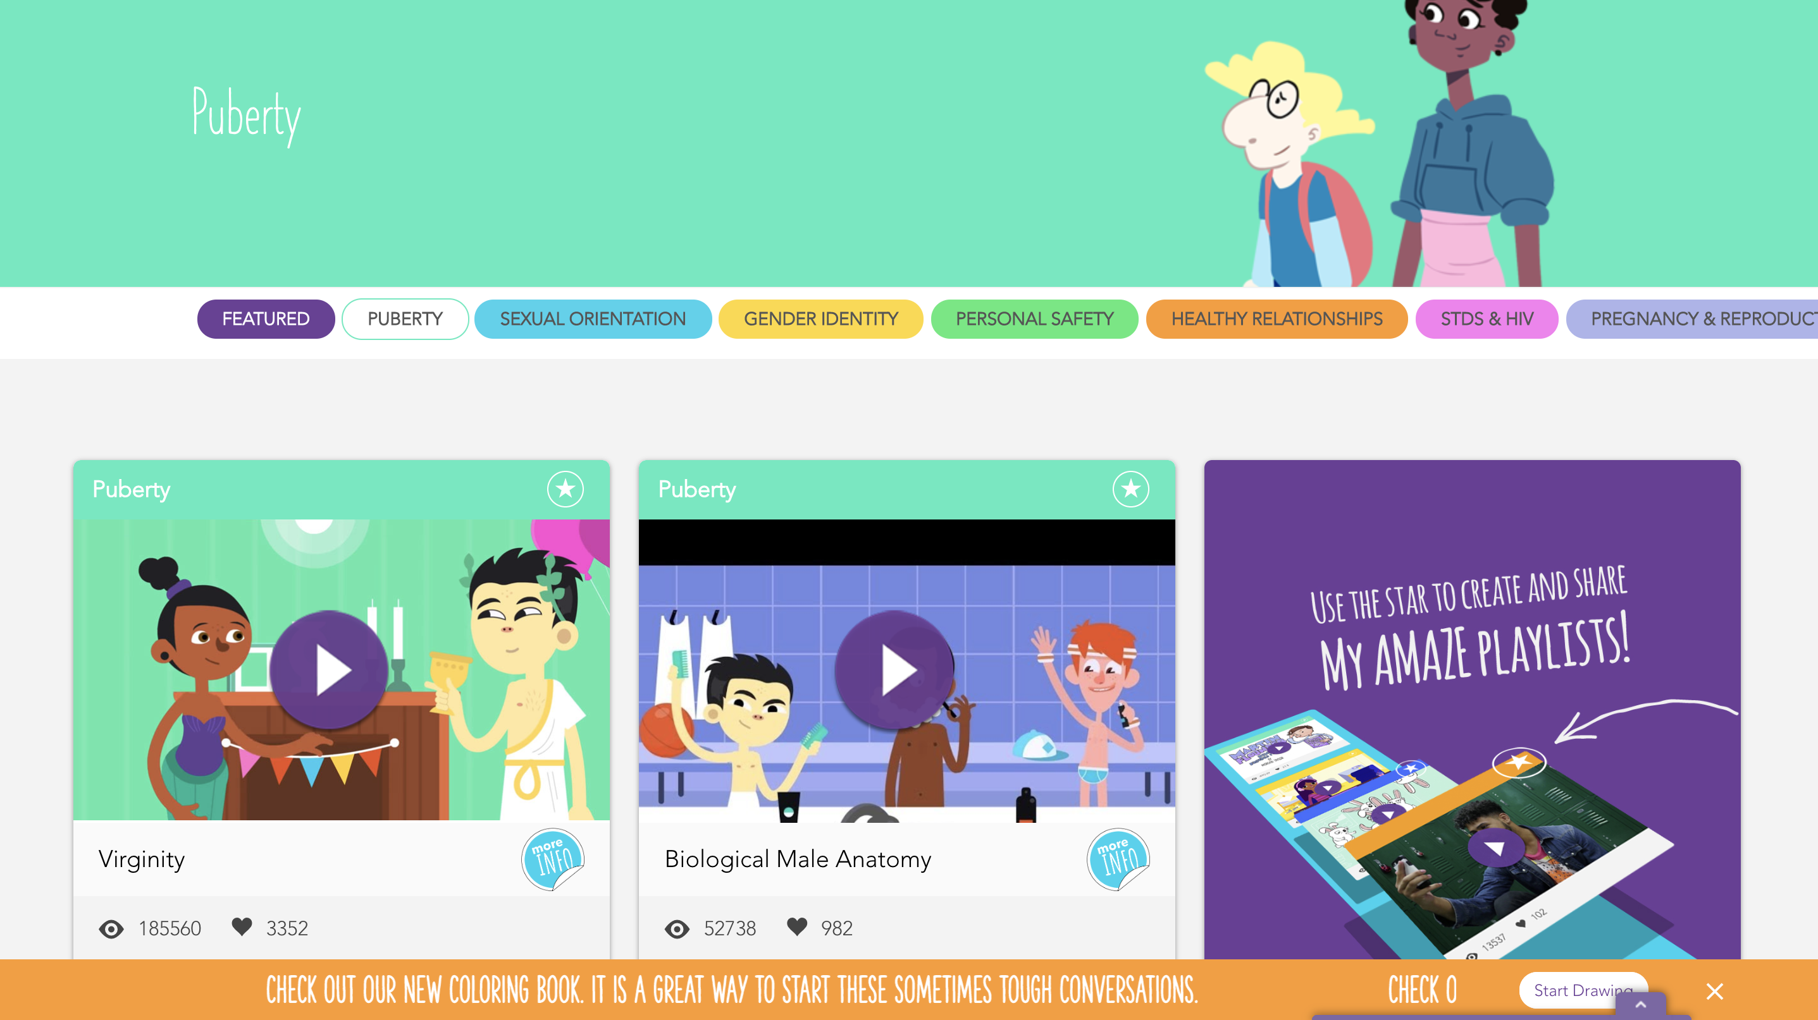
Sample Tweens/Early Adolescents Resource: www.amaze.org

Slide 43
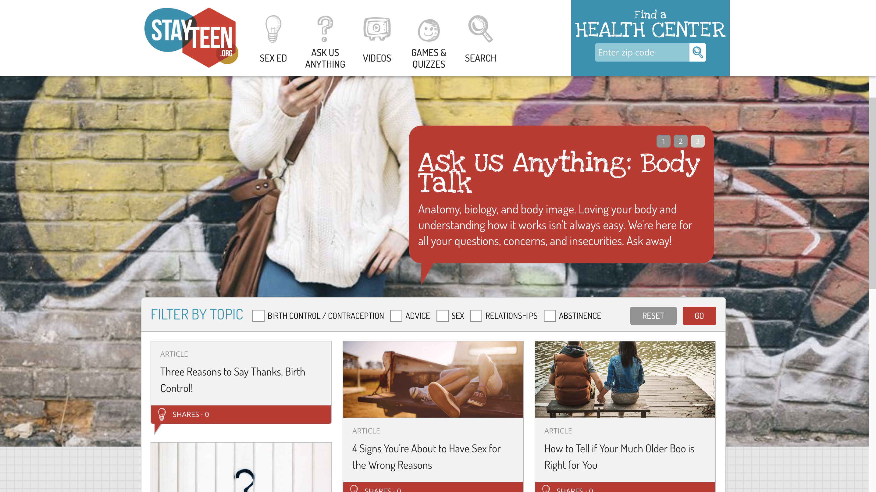
Sample Middle Adolescents Resource: www.stayteen.org

Slide 44
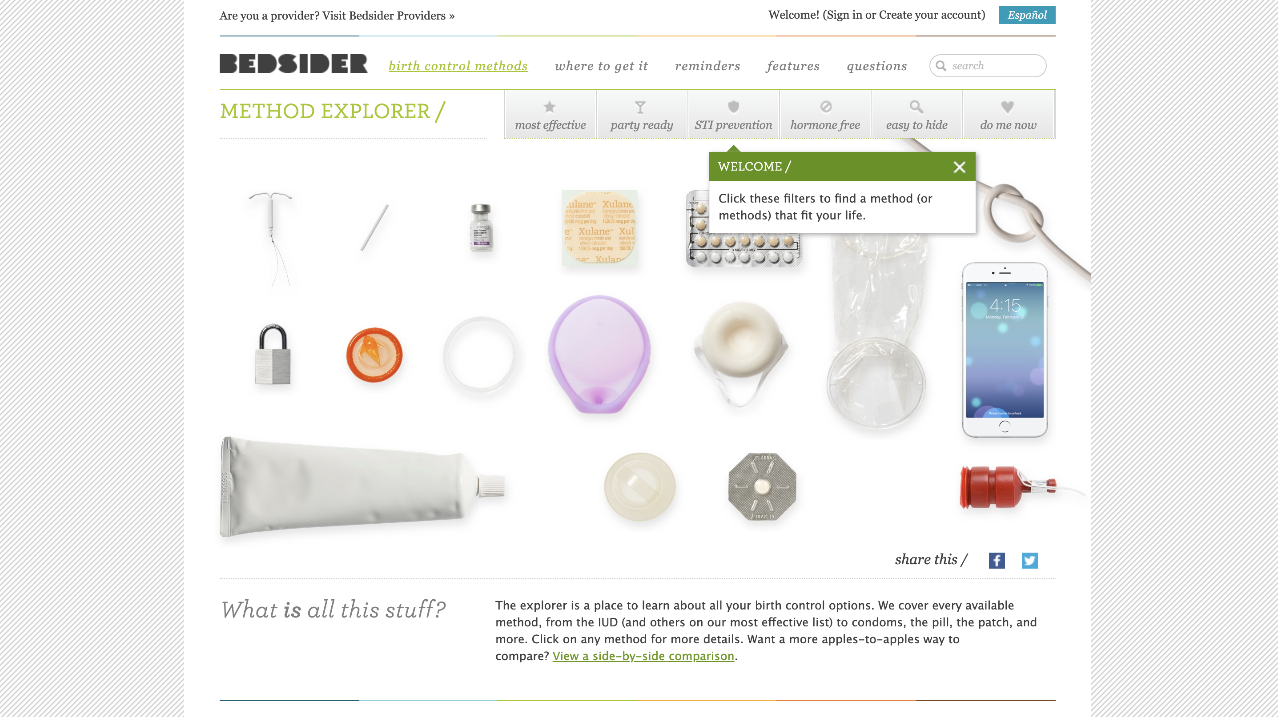
Sample TAY/Young Adult Resource: www.bedsider.org

Slide 45
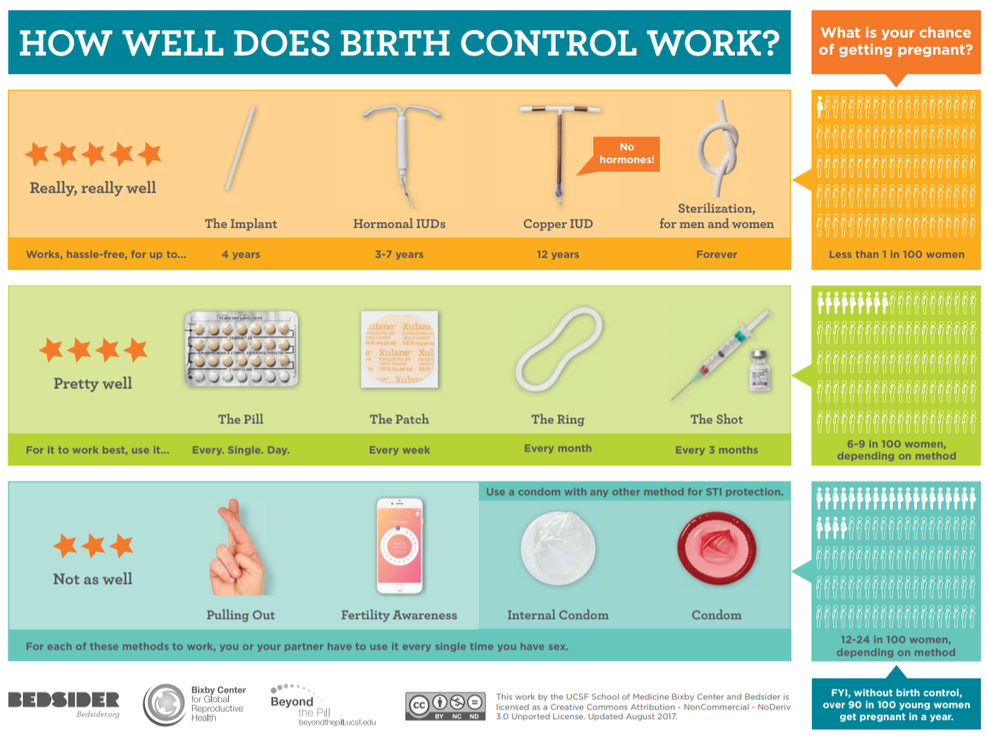
Contraception
Resources:
Tip & Tools for Trusted Adults:
Available at: www.bedsider.org
45
45

Slide 46
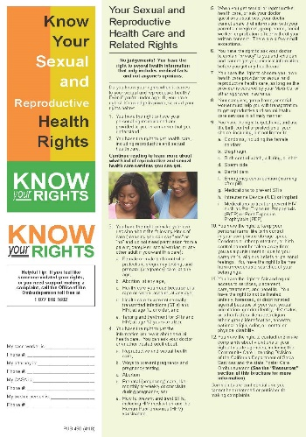
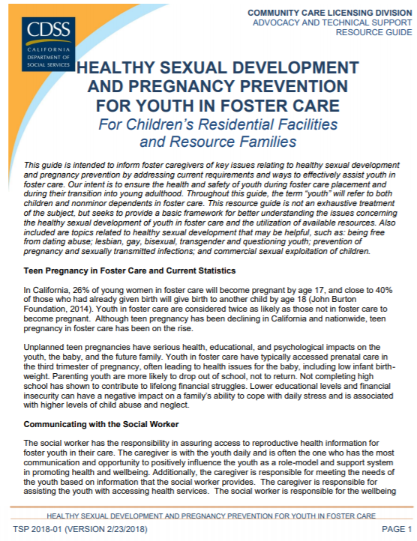
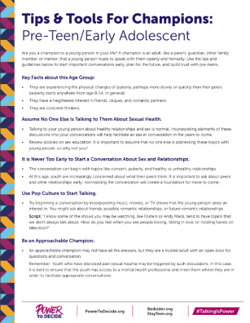
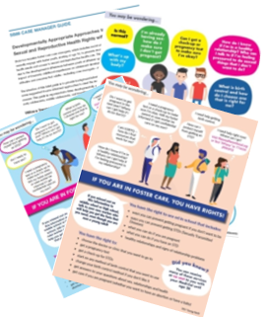
Questions & Post-Test
Take some time to take the post-test & debrief on answers.
This training is just a brief overview--use resources & additional training available to you!
Additional training can be found here:
https://calswec.berkeley.edu/sexual-and-reproductive-wellness-foster-care-sb-89
http://www.cdss.ca.gov/inforesources/Foster-Care/Healthy-Sexual-Development-Project/Available-Trainings
REMEMBER, YOU HAVE A TEAM!
46
46
Notes:
Due to time constraints, encourage participants to ask questions after training if they have lingering questions. Remind participants to complete post-test and go over answers!

